Slide 1
A lot of information…but don’t freak out
You are not intended to remember all of this in one sitting
The material which follows is intended as
A survey/summary of many topics
A catalyst/jumping-off point
  Hopefully someone will be enticed to follow up one or more of these topics in depth
A reference (CliffsNotes-level)
Lessons from numerous classes of all levels are found in these pages

Slide 2
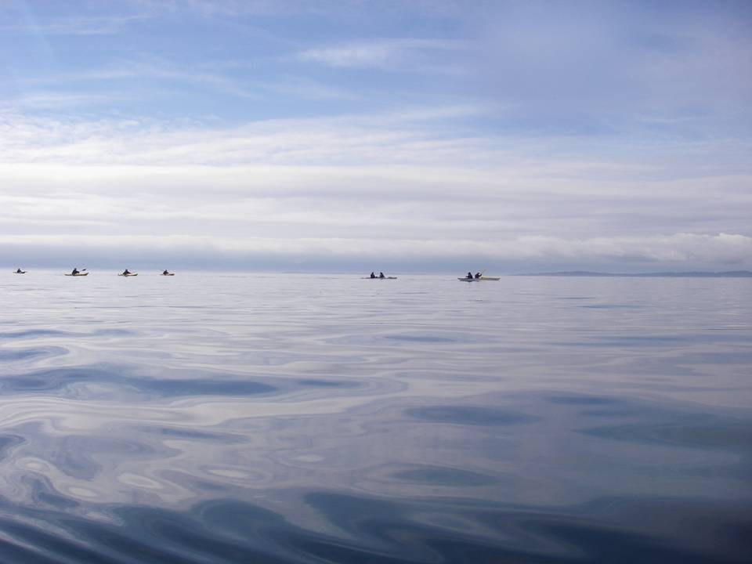
Paddler Development Workshop
Planning and Participating in Paddling Trips
Joanne Barta, Tim Mattson,
Fred Harsman, Don Beale, David Dalbey, Bob Baltazar, Charles Congdon, etc.

Slide 3
About the Authors
This training was developed by OOPS for OOPS Trip Organizers from about 2008-present. It was put together by experienced paddlers with a wide range of advanced training representing both American Canoe Association (ACA) and British Canoeing (formerly known as the British Canoe Union - BCU).
Joanne Barta
  ACA Level 3 Instructor certification. Other training includes Strokes and maneuvers from Nigel Foster; Instructor training, Risk management, Rescues with Body Boat Blade; Risk Assessment and Management, surf training with Karl Anderson; surf, BCU 3 star training with Ginni Callahan; and rolling instruction with Cheri Perry and Turner Wilson. She enjoys teaching Risk Assessment and Management, Rescues, and How People Learn.
  She participated in LoCo Roundup, and several Qajaq USA symposia (SSTIKS, Michigan Training Camp; The Traditional Paddlers Gathering; HRGF; Delmarva; TIPS). Taught Outdoor Leadership at Pacific University since 2015 teaching Beginning Kayaking, Sea Kayak leadership, Outdoor Recreation, and Kayak Guiding. Past OOPS Education Coordinator
Tim Mattson
  Tim has been paddling since the mid 90's in white water rivers, rough coastal shorelines, and, of course, peaceful quiet waters. He is a retired ACA certified instructor (level 5: advanced open ocean) and instructor-trainer (level 3: coastal kayaking). He was active for many years in the Puget Sound kayak racing scene and helped found the Northwest's premier traditional kayaking symposium (SSTIKS). Wilderness First Responder.
Fred Harsman
  British Canoeing 4-star sea kayak (sea kayak leader), and ACA coach 3. Other training includes coaching clinics / classes / training sessions with top instructors including Nigel Foster, Shawna Franklin ,Gordon Brown, John Walpole, Karl Anderson, Tim Mattson, John Wallum, and others. Plays in the ocean and like to rock garden and surf my kayak, and has done numerous BC coastal trips (favorite being a 12 day trip in the Hakai area of BC). Worked and taught kayaking at Portland Kayak for 18 years. One of the original folks who put together the syllabus for the Trip Organizer training along with Joanne Barta, Bob Baltazar, Don Beale, and Tim Mattson
Don Beale
  ACA level 5 instructor, and BCU 4-star sea leader. Dedicates time and funds for professional training each year. Teaches kayaking and Greenland paddle carving at the Oregon Ocean Paddling Society, SSTIKS (South Sound Traditional Inuit Kayak Symposium), and other Greenland events in the US and abroad.
David Dalby
  Personal awards: British Canoeing 4-star sea kayak (sea kayak leader), 3-star canoe, BCU Level-1 coach with Level-2 training. Guided and taught with Alder Creek 2011-2016, (still teach & guide periodically). Past OOPS Trips Coordinator, Education Coordinator and President.
Charles Congdon
  British Canoeing 3-star sea kayak, 3-star canoe, BCU Level-1 Coach. Other training includes clinics / classes / training sessions with top instructors including Nigel Foster, John Walpole, Shawna Franklin and Leon Sommé, Rob Yakes, Ginni Callahan, Nick Cunliffe, Karl Anderson, Tim Mattson, Paul Kuthe, Sherry Perry and Turner Wilson. Favorite classes include Dynamic Water Rescues, Incident Management, BCU Coastal Navigation, and Coaching the Mind. Oregon Emergency First Responder. Enjoys teaching Rescues, Rolling, Navigation and Trip Planning (on and off the water)

Slide 4
Please Introduce Yourself
Name
A few things about yourself
How long have you been paddling?
How long have you been with OOPS?
Why are you here?

Slide 5
Agenda
Goals
Logistics and Legal
Trip Planning
  Trip Levels, Skills
  Conditions
  Safety & Risk Assessment
  Medical Issues
Group and Incident management

Slide 6
Class Goals
To introduce some of the skills needed to plan and take part in fun and safe paddle trips in the beautiful Pacific Northwest including:
  Finding a place to paddle
  Judging the conditions before and during a trip
  Being safe around other water users and in-water features
  Dealing with medical issues
  Managing a group
  Being a good organizer or paddler
  Being inclusive – make the trip work for everyone, even if someone is above their head
To encourage you to grow as a paddler in skill and knowledge

Slide 7
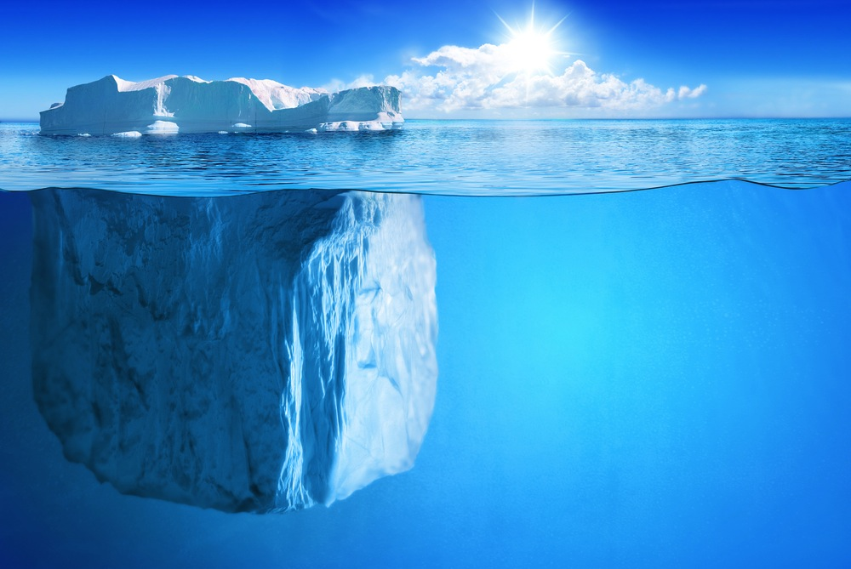
Lifelong Learning – it’s about more than moving the boat!
  Effective Paddling, Turning, Edging, Steering
Paddling
  Rolling
  Moving-Water Paddling
  Rescue Techniques
  Towing
  Tidal/Trip Planning
  Navigation in Conditions
  Group and Incident Management
  Weather
  Teaching Physical Skills
  Marine geology, hydrology, and biology
  Native Cultures
  Ropes and Knots
  Boat and paddle design
  Camping out of a boat
  Etc.

Slide 8
Our Goals as Paddlers
To make sure everyone has a great time
To learn and grow as paddlers, so we can better take care of each other and have fun
To get home before serious environmental, medical, or personal problems arise
To never, ever, have to call someone and tell them that their loved one will not be coming home
  Paddling is not without risks

Slide 9
Paddler Responsibilities
All Paddlers
Have appropriate equipment (including immersion wear)
Know where to go, and how to get back (navigation)
Good decision-making skills (experience, and appeal to the wisdom of the group)
Make the trip safe—stay within acceptable risk—read conditions
Keep an eye on the clock—time management.
Be prepared for all conditions seen on trip (weather, tides, etc.)
Communication: keep everyone in the loop, communicate early and often
Stay with the group – no one leaves without permission, even the leader
  Help the group find you again if you get separated – stay in a place widely visible, signal, enhance visibility
Be reasonably self sufficient.
  OOPS does not run a guide service

Slide 10
Paddler Responsibilities
Organizers
Set up the trip and rate it properly, deal with waivers, write post-trip report, etc. (administration)
Making sure the appropriate equipment is on hand (first aid kit, tow belt, etc) .. Both for the organizers and participants.
Keep the group together – “herding” and leadership
Find all possible bailout options along your possible projected trip
Decide how to handle popular trips (form pods, recruit other organizers to propose additional staggered trips to handle overflow, etc.)
Screen participants

Slide 11
What if something goes horribly wrong?
If there is an incident, the most experienced professional paddlers from Alder Creek, Next Adventure, Portland Kayak, Body Boat Blade, Columbia River Kayak, etc. will be witnesses for the prosecution
They will be asked if the participants (especially leaders) of the paddle exercised proper “duty of care” based on industry standards, and did not lead participants into harm due to negligence or incompetence
We want to be sure that all paddlers will receive a positive review from these paddling experts

Slide 12
Resources
Check out the “Paddler Resources” page under the “Information” menu on the OOPS website (https://oopskayak.org/onlinepaddlingresources).
There you will find:
Map and charts
Weather, Wind, Tide, Current, Temperature, and Pollution information
Paddle Locations, Launches, water trails, suggested trips, etc.
Want to learn a new skill?
Check out our learning resource page https://oopskayak.org/onlinelearningresources or take a class from one of our fine local paddling stores.

Slide 13
Agenda
Goals
Logistics and Legal
Trip Planning
  Trip Levels, Skills
  Conditions
  Safety & Risk Assessment
  Medical
Group and Incident management

Slide 14
OOPS in the Land of Liability
Insurance:
  OOPS has liability insurance:
    Protects the club, its leaders and volunteers if we are sued
    Protection only holds if we act according to standard practice established by “experts” in the sport.
      See the ACA SEI risk management article.
How to keep our insurance
  Understand and follow the rules
  Document EVERY trip: conditions, people, events…
  Same standards for EVERY trip
Without the Insurance, trip-organizers and instructors couldn’t afford to risk involvement with OOPS.
No insurance … no OOPS.

Slide 15
The Rules for OOPS Trips
Our insurance requires us to define Policies and follow them.
Those policies come from:
  Common sense… and professional standards
Key rules (full list in the OOPS Activity Policy document)
  Equipment appropriate to the trip:
    PFDs, sprayskirts, bilge pump, whistle, first aid kit, food/water, etc.
  Dress for immersion risk.
    No cotton except in very specific circumstances
  Limited group size
  Keep the group together!
  Waivers and pre-trip talks are required
  Every trip has a CPR certified first aid person.
  Fill out ALL required trip paperwork (there isn’t much of it)
Organize trips a full level below your own ability.
  E.g. If you can only safely paddle up to level 3, you should only organize up to level 2 trips.
Rules set minimum standards … anticipate, adapt, and stay safe.

Slide 16
Running a Personal Trip
Figure out when and where you want to go:
  Check conditions, experiences of other paddlers, personal logs
Decide who you want include on the paddle and maybe change your plan to suit their skills:
  Your new friend who has never paddled before probably isn’t up for a 20-mile trip down the Columbia
At the Put-in BEFORE getting on the water:
  Decide who is the nominal leader and agree on signals
  Find out what gear everyone has and if anyone has medical issues
  Discuss plan, who needs to get back when, and possible hazards
After the trip
  Tell wild fish tales about what went right
  Discuss problems and near-misses
  Make sure any injuries are dealt with, and everyone can safely drive home

Slide 17
Running an OOPS Trip
documents and trip organizer information available at: https://oopskayak.org/Documents
Before the trip is advertised:
  Submit your Trip organizer resume:
    Fill out and submit to OOPS Trips Coordinator for OOPS’ files. You only need to do this once.
  Fill out the trip proposal form at the bottom of https://oopskayak.org/Trips :
    If approved, it will be posted on the calendar and announced on the listserv by the OOPS Trips Coordinator.
Once the Trip is Posted:
  Screen trip participants / build roster / recruit co-organizers / sign up yourself!
At the Put-in BEFORE getting on the water:
  Every participant including trip leader fills out the activity roster/waiver
  Conduct the trip briefing/safety talk
After the trip
  Fill out the Post-Trip report at the bottom of https://oopskayak.org/Trips :
    Send to OOPS Trip Coordinator right after the trip along with the signed release form(s)
  Trip incident report:
    Fill out if there are incidents … even small ones. You never know when something trivial may grow into something serious.

Slide 18
Information you will need to Submit an OOPS trip
Decide on a location, on-water time, total distance, put-ins and take-outs.
  Research parking spaces and fees
  Find possible landings for emergencies, rest-room, and lunch breaks. Research the type of landing at all locations
  Measure any open crossings
Decide on a date, meeting time, launch time (taking weather, tide, currents into consideration)
Get co-organizers, first aid/CPU person
Research projected water and air temperatures, weather, sea state, swell, and wind speeds
  Use these and venue/hazards to decide immersion protection, helmet, tow rope, etc. requirements
Research tides (Columbia west of Bonneville, Willamette north of Oregon City) and currents 12 hours on either side of trip
Use all of the above to figure out a rating for the trip
See https://oopskayak.org/Trip-Rating-System for more details

Slide 19
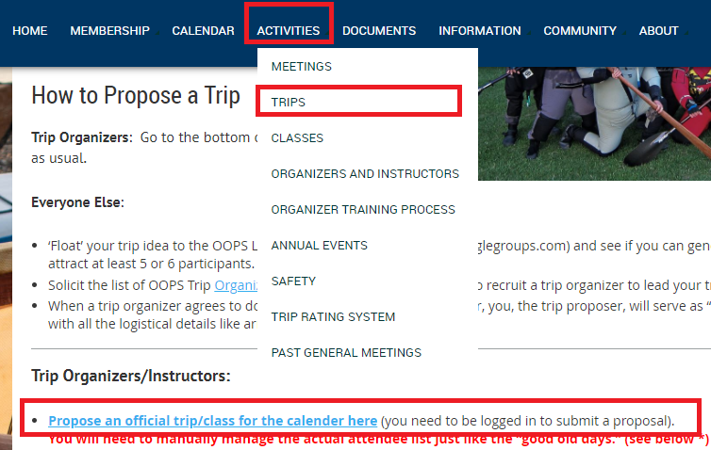
Submitting your Trip
Make sure your personal OOPS account is tagged as “Trip Organizers” or “Provisional Trip Organizers” (needed to access trip submission form)
Fill out the trip submission form at https://oopskayak.org/Trips

Slide 20
When submitting an OOPS trip
If you need extra help, e-mail organizers@oopskayak.org before you propose your trip to see if you can get some co-organizers to join you (lets you bring more people)
You and your assistants must sign up as soon as the trip is posted
  The participant limit enforced by the website includes you and your assistants
You need to manually maintain the attendee list and check wet-exit status
  Wet exit status will be noted in the registration e-mail you get
  The website will maintain the order of signup and will automatically move the next person off the waitlist if a registered person cancels correctly
  On some trips (especially higher level) the waitlist will be maintained by personal communication
You need to manually e-mail participants with trip details, etc.
  Although you can point them to the Trips forum to work some of that out
Paid events are handled a little differently – ask if you really need to know

Slide 21
The pre-trip interview
Make sure people are right for the trip
  If you don’t know them, talk to them (phone or email):
Ask them about:
  Are they wet-exit certified (should be noted on the copy of their registration e-mail)
  Do they have the experience they need? Where do they like to paddle?
    Watch out for know-nothing “experts” and over-confident “pros”.
  What do they do when they capsize?
  Dynamic Water: how consistent is their combat roll, and when did they last use it?
  Do they have the right equipment and clothing?
  Are they in shape for the planned trip?
  Any medical issues? A diabetic will need to stop to eat frequently
    Doesn’t disqualify them, but you need to plan for this and have a trip where it is possible
When in doubt, gently guide them to a more appropriate trip.

Slide 22
Sample participant questions
After Charles took this class, he asked people so many questions they were scared away.
Here is what he asks them now if he doesn’t know them or their skill level:
  (Ocean Classes) What skills do you wish to work on at the coast in lumpy waters?
  (Ocean Paddles) What sort of coastal paddling have you done, and what do you consider your upper level?
  Can you tell me about some of your recent paddles?
  What sort of immersion gear do you have (do you have a drysuit, wetsuit, etc.)?
  When was your last wet exit and rescue (intentional or otherwise)?
  What do you want to get out of this trip/class?
  Do you understand why this trip/class was rated at level XX?

Slide 23
Exercise: the pre-trip interview
Conduct a pre-trip interview. During an OOPS event in Washington we are going to be doing rescue practice in Canoe Pass at Deception Pass
Key points to note:
  Be encouraging.
  Be realistic … remember if you give in and let an unprepared person join the group, everyone suffers.
  Steer the person to a more appropriate OOPS trip if that makes sense.
If people need it

Slide 24
Mandatory Organizer Tasks the Day of Every OOPS Trip
Make sure you arrive prepared with the latest weather, wind, swell, tide, and current information for 12 hours on either side of the trip
  Strongly encourage your participants to come prepared as well – quiz them!
Arrive early so you can meet people and redirect to a Plan B paddle if necessary
Make sure everyone signs the waiver
Check on equipment as it arrives (proper boats, immersion wear)
Get people help taking boats to/from cars to water
Conduct the official pre-trip briefing (use Pre-trip Checklist and Trip Rating Guide on website)
  Introductions
  Verify everyone signed waiver
  Discuss itinerary, rest stops, lunch spots, bail outs
  Get everyone to identify possible risks, conditions, hazards, medical conditions
  Safety discussion (mutual comfort, capsizes, towing)
  Go over communication methods
  Equipment check, who has what, radio and zipper checks
  Group Expectations
Give people a place to meet when launched, then get someone experienced out there first

Slide 25
Another way to remember what to cover before you get on the water (personal trips)
M. Y. A. B. C. D. E.
  Me – Introduction and a bit about me
  You – introductions from the group
  Area – the plan for the day, the water we will be on, and the “type” of trip we will be undertaking
  Boats and kit – safety check and also who has what kit and where
  Communication – how we will communicate, signals we will use
  Doctor – invitation for anyone to let me know of any relevant medical needs and a reminder for people to carry any relevant medication
  Emergency – what to do if an emergency occurs – a swim brief and what the rest of the group should do

Slide 26
After your paddle returns to the take-out
Just before landing, ask people to gather before leaving and share feedback
Double-check that everyone signed the waiver
Help people get their boats back on their cars
  People will be tired and forgetful
  If there is a wind, make sure someone is always actively holding a boat until someone else secures it to the car with at least one strap
Make sure everyone has had something to eat and drink before they drive away
  To prevent falling asleep at the wheel on the way home
  Or gather a local eating joint for a meal together
Make a quick note of anything you want to put in the post-trip report (conditions seen, unexpected hazards, people who did really well or had troubles, rescues done, first aid given, equipment failures, etc.) or privately communicate to the Trips Board member.
E-mail a double-sided scan of the signed waivers to the Trips Board member (trips@oopskayak.org) or deliver it to them in-person.

Slide 27
Preparing to submit a Post-Trip Report
These are much easier than the original proposal. You will need:
Trip name and date
A list of participants including organizers
A list of organizers who were on the trip (including yourself)
Details on any unexpected conditions and whether the first aid kit was used
The overall rating of the actual paddle (see https://oopskayak.org/Trip-Rating-System )
Were there any incidents that could result in a suit against OOPS?
Do you want to have a private discussion about the trip with the Trips Board member?

Slide 28
Writing the Trip Summary
Save flowery prose for Facebook or the Listserv
Be factual – this is for learning purposes and to refresh you memory later
  Get your times right
  Report the correct order of events in detail that would help you or the next person anticipate what they might see if they paddled there
  Document incidents in as much detail as possible
  Document difficult decisions in as much detail as possible
  Note paddlers who did really well, struggled a lot, or who were a management challenge (and how you dealt with the latter)
  Other items of note: (neat wildlife, first OOPS trip for someone, paddler that wandered, hazards encountered/avoided, great lunch spots encountered, things you might have done differently, etc.)
  Make this a useful reference for the next time you or someone else plans on taking the same trip.
Do it while the memories are fresh
This document might be used in court if something went wrong
If you need to vent, report someone who was a real problem, risky behavior, etc., contact TOHelp@oopskayak.org - non-organizers can use this too!

Slide 29
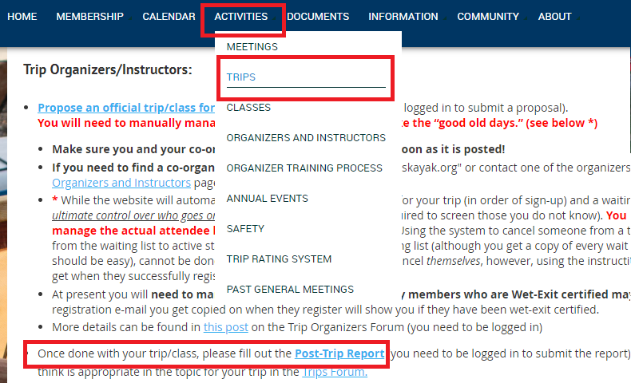
Submitting your Post-Trip Report
Make sure your personal OOPS account is tagged as “Trip Organizers” or “Provisional Trip Organizers” (needed to access post-trip report form)
Fill out the post-trip report form at https://oopskayak.org/Trips

Slide 30
Life in America: the Land of Litigation*
The Bad and the Ugly:
  “Experienced Paddlers”/Trip Organizers are liable … whether the trip is with friends, an OOPS trip, or professionally guided trip.
Friends, clubs, professional guides … what’s different?
  Consider The PERCEPTION of liability. Two extremes:
    Friends usually don’t sue friends (but relatives might…), so we often neglect liability protections when paddling with friends.
    Paid guides: High expectations … fair game for law suits
  What about a large club such as OOPS?
*From the May 2010 SEI Focus, pp 3 to 5. Adapted by Sam Fowlkes from a Risk Management Seminar given by Will Leverette at the 2004 Whitewater Symposium. Reproduced without permission as an appendix to these slides. SEI = Safety Equipment Institute
Notes:
Hi Tim,
Here's what Im thinking: First slide, the 'bad and the ugly':
WE ARE LIABLE.
Exposure to liability is the same whether we go out with friends, lead an OOPS trip, or are a professional guide.
Next slide: What is different?
Whats different is the PERCEPTION of liability. Nobody wants to sue our friends, we have 'vested interest' in them. So in a small club, or just a group of friends, no one carries insurance or puts much thought into the liability issue.
At the other end of the spectrum is a paid guide, where the perception of liability is clear.
Where does OOPS fall on this scale? In club size? In responsibility? ( a few minute discussion, hopeful result is that OOPS is somewhere in the middle).
Next slide:
The standard of care:
Anybody remember that from the article?
"to perform as a reasonable and prudent person with your level of training and experience would perform under similar circumstances'.
In OOPS, we try to maintain a balance where the perception of liability is that each person is responsible for thier own safety, while at the same time taking some assurances that our Organizers will perform in a reasonable and prudent manner.
Next slide:
What was the #1 thing in the article that we need to do to protect ourselves? (Informed consent, or 'warn and inform')
What systems does OOPS have in place for this?
-the waiver, signed at every trip
-the rating system
-the pre-trip debrief
Does that about cover it? Thats four slides, and I think total 20 minutes.... Also attached is the Cascade Head pdf... -Don

Slide 31
Thriving in the Land of Litigation*
Set a high standard of care … or in lawyer speak:
  "to perform as a reasonable and prudent person with your level of training and experience would perform under similar circumstances”.
The OOPS approach:
  Maintain a balance of responsibility … each paddler is responsible for his/her safety … while the club takes steps to help our trip organizers perform in a reasonable and prudent manner.
From the SEI Focus article*, what is the #1 approach to protecting ourselves?
  Informed Consent … or “warn and inform”.
How does OOPS implement this strategy?
  The waiver signed on every trip
  The trip rating system
  The pre-trip briefing
*From the May 2010 SEI Focus, pp 3 to 5. Adapted by Sam Fowlkes from a Risk Management Seminar given by Will Leverette at the 2004 Whitewater Symposium. Reproduced without permission as an appendix to these slides.
Notes:
Hi Tim,
Here's what Im thinking: First slide, the 'bad and the ugly':
WE ARE LIABLE.
Exposure to liability is the same whether we go out with friends, lead an OOPS trip, or are a professional guide.
Next slide: What is different?
Whats different is the PERCEPTION of liability. Nobody wants to sue our friends, we have 'vested interest' in them. So in a small club, or just a group of friends, no one carries insurance or puts much thought into the liability issue.
At the other end of the spectrum is a paid guide, where the perception of liability is clear.
Where does OOPS fall on this scale? In club size? In responsibility? ( a few minute discussion, hopeful result is that OOPS is somewhere in the middle).
Next slide:
The standard of care:
Anybody remember that from the article?
"to perform as a reasonable and prudent person with your level of training and experience would perform under similar circumstances'.
In OOPS, we try to maintain a balance where the perception of liability is that each person is responsible for thier own safety, while at the same time taking some assurances that our Organizers will perform in a reasonable and prudent manner.
Next slide:
What was the #1 thing in the article that we need to do to protect ourselves? (Informed consent, or 'warn and inform')
What systems does OOPS have in place for this?
-the waiver, signed at every trip
-the rating system
-the pre-trip debrief
Does that about cover it? Thats four slides, and I think total 20 minutes.... Also attached is the Cascade Head pdf... -Don

Slide 32
Common Problems and Staying Safe
The six most common and significant allegations are listed below in order of importance and prevalence:
  Failure to “warn and inform”
  Failure to give proper instructions
  Instructor/ guide error
  Wrong place, wrong time
  Equipment failure
  Rescue was unduly long and exhaustive, causing pain and suffering
Paddlers can build a solid defense if the points above are properly addressed
  The bottom line is prevention. Proper training, knowledge and experience gives paddlers the judgment to recognize when a situation is developing and the tools to take both preventative and corrective action.

Slide 33
ACTIVITY POLICY QUIZ: Part 1
You are organizing a level-three trip, and a participant does not have a tow belt. Is this in compliance with the Activity Policy?
  Yes – a tow belt is recommended but not required.
Must each item in the safety checklist be reviewed prior to every trip?
  No – the checklist is a recommendation. Some items on it will be more applicable on some trips.
You are organizing a level two trip, and are planning on twelve total participants. How many Organizers or Assistant Organizers do you need?
  Two – there must be one organizer for every 5 non-organizer participants at level 2.
What is the minimum Organizer/Participant ratio for level three?
  One Organizer for every four participants at level three, and one for every three at level four.
Does an assistant need to be an approved Organizer?
  Yes – assistants must also be organizers

Slide 34
ACTIVITY POLICY QUIZ: Part 2
True or False: One first aid-certified person per Organizer or assistant is required.
  False – one first aid kit meeting OOPS standards and one person with current first-aid and CPR training is required for every pod.
What cotton clothing item is allowed on OOPS activities on the water?
  An exception to the ‘no cotton’ rule is made for a hat.
For a minor in an OOPS activity, what accommodation is required?
  There has to be a designated ‘responsible adult’.
Does the responsible adult for a minor have to have express permission to authorize medical treatment and transport?
  Yes.
In the event of an incident, who does the Organizer notify? Who notifies the Club President?
  The Organizer notifies the appropriate Trips/Education Coordinator. The Coordinator then notifies the President.

Slide 35
Bottom Line
As a club, OOPS has to follow certain polices to minimize risk in a risky sport
  These are mandatory to keep our insurance coverage
    Including waivers, pre-trip briefing, and post-trip report
  They are found in the Activity Policy
We try to balance responsibility of club and individual paddlers
Think about these issues when planning private trips as well

Slide 36
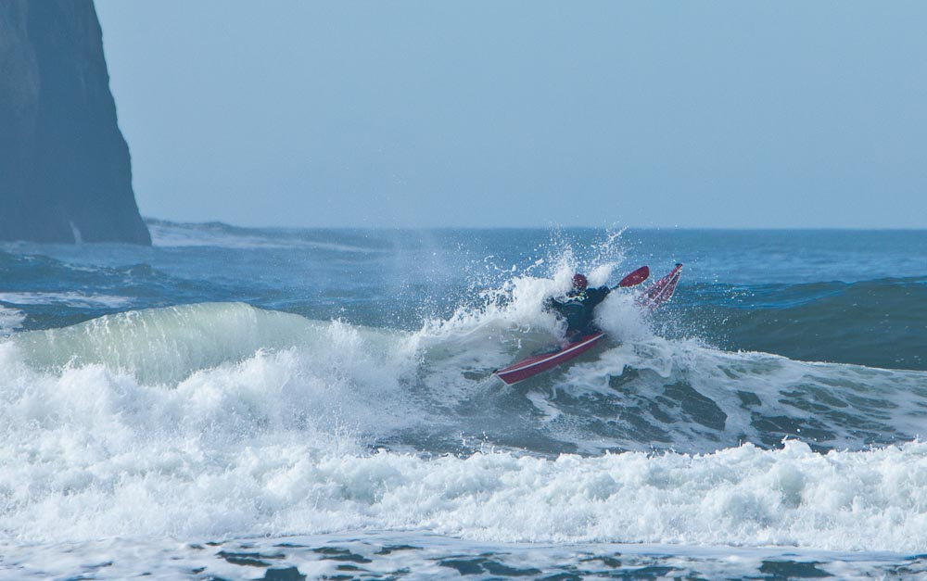
Agenda
Goals
Logistics and Legal
Trip Planning
  Trip Levels, Skills
  Conditions
  Safety & Risk Assessment
  Medical Issues
Group and Incident management

Slide 37
When planning a trip, what are the most important considerations?
A topic of much discussion
Paddle from Safe Haven to Safe Haven
Paddlers of all levels are most bothered by
  Wind & Waves (particularly wind)
  Lack of bailout options
  Lack of local knowledge
Beginners will find it all challenging
  Pick short paddles on a calm day in flat water for beginners
  If they come home all-smiles, consider it a job well-done
    In time they may get better and be up to the “exciting stuff.”

Slide 38
OOPS Trip levels
See https://www.oopskayak.org/Trip-Rating-System for definitions
Condition | Level 1 | Level 2 | Level 3 | Level 4 | Level 5
Wind | Under 8 mph | Up to 14 mph | Up to 19 mph | Up to 25 mph
Sea State as seen from boat | Waves up to the deck seam; water glassy to rippled, no whitecaps | Waves up to armpit; light to moderate chop, scattered whitecaps | Waves to paddle tops; numerous whitecaps, waves becoming longer | Many whitecaps, some spray
Waves, breaking waves | waves < 1’ no breaking waves | Waves to 2', no breaking waves | Waves to 3', 2’ breaking waves | Waves to 6', breaking waves < 4’
Landing Type | Frequent easy landing opportunities including gently sloping, sand, gravel or grass | Frequent landing opportunities including docks or moderate sloping banks, brush or overhanging trees | Bad footing, surf up to 1.5’ | Steep rocky shores sheltered from the waves or surf up to 4'
Open Crossings | No open crossings | Under 1 mile | 1 to 2 miles | 2 to 4 miles
Total Distance | Up to 6 miles | 6 to 11 miles | 11 to 15 miles | 15 to 22 miles
Current | None or mild (less than 1 knot) | Mild currents (up to 2 knots): current increases / decreases group speed by half | Up to 4 knots: paddlers must sprint to move forward | Up to 6 knots
Exceed any two level 4 conditions
Three or more level 4 conditions present
Any two conditions exceeding a level’s listing bumps the rating up to the next level.
Night or limited visibility (fog) bumps the rating up one level. Changes in conditions just before trip may increase level as well.

Slide 39
Recommended Skills per level
 | Level 1 | Level 2 | Level 3 | Level 4 | Level 5
Paddling | Forward, reverse, sweep turns, stern rudder | High and low bracing. Comfort with some edging. Efficient forward stroke. | Eddy line crossings. Confident edge control and bracing. | Confident boat control in wind and moving water. Reliable roll. | Reliable rough water roll.
Rescue | Wet exit ability | Confident wet exits and assisted rescues (as swimmer and rescuer). Paddle float or other self-rescue. | Confident assisted and self rescues. | Recently rehearsed assisted rescues in Level 3 or Level 4 conditions. | Confident rough water assisted rescue ability.
Group Dynamics | Group positioning awareness | Group positioning and dynamics awareness. | Group management ability. | Confident group management experience. | Confident group management experience
Navigation |  |  | Basic navigation skills. | Accurate course plotting and chart positioning skills. | Night and limited visibility navigation

Slide 40
Exercise
Pretend that we are going to paddle in Nehalem Bay today. How would you rate the paddle?
  Wind waves are a bigger deal than swell
  Don’t forget current!
  The website does not automatically calculate the overall rating, which usually is the highest rating level seen 2 or more times (+1 for night and fog + more for conditions)
You had a good trip. What information would you pass on to the next organizer that you discovered in your research?

Slide 41
Paddles where special care is needed
A level 1 trip when conditions start to worsen
  When one person has problems, many will follow
    The kayak shops see this all the time
  Which is why it’s always good to have a other experienced paddlers with you
Any paddle (especially level 2) in an environment where the wind can come up “without warning” and/or there are very few or difficult outs
  This could quickly turn into a level-4 mess

Slide 42
Paddling from Safe Haven to Safe Haven
Don’t just plan on breaks at the put-in, take-out, and lunch.
Try to plan trips with places you can land about every half-hour to hour or so (every few nautical miles) so that:
  People can use the restroom
  Hot people can take off some clothing, cold people can put on some extra clothing, wet people can change
  People can snack (especially diabetics)
  People can stretch
  Slow people who are always “humping it” to keep up can rest
  Someone can go for help if needed
You don’t have to land, and if you do, make it short.
But make sure you have the option

Slide 43
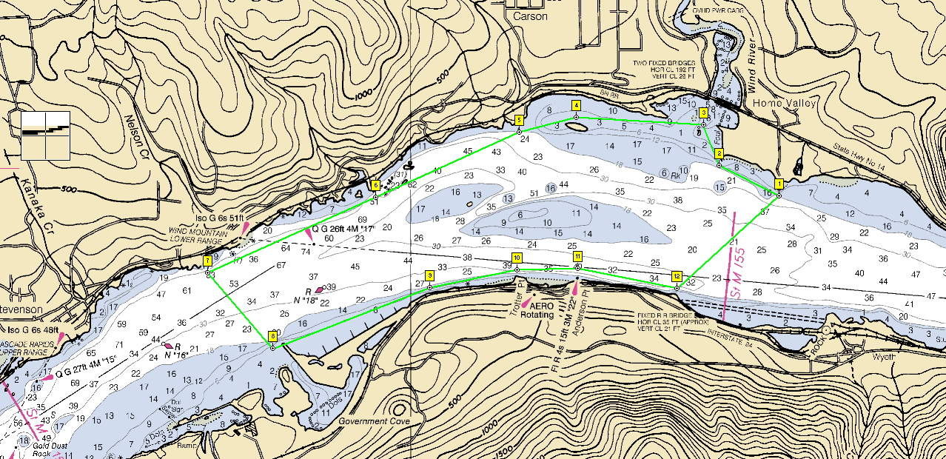
Rate this trip: Wind river
Expected Wind is from the NW at 10 knots.
Currents are 2 knots
Crossing distance is 1mile.

Slide 44
Rate this trip: Wind river
We arrive and the actual conditions are:
  Wind is west at 20 knot.
  Current at 2 knots, crossing is 1 mile
Re-rate this trip for the actual conditions.

Slide 45
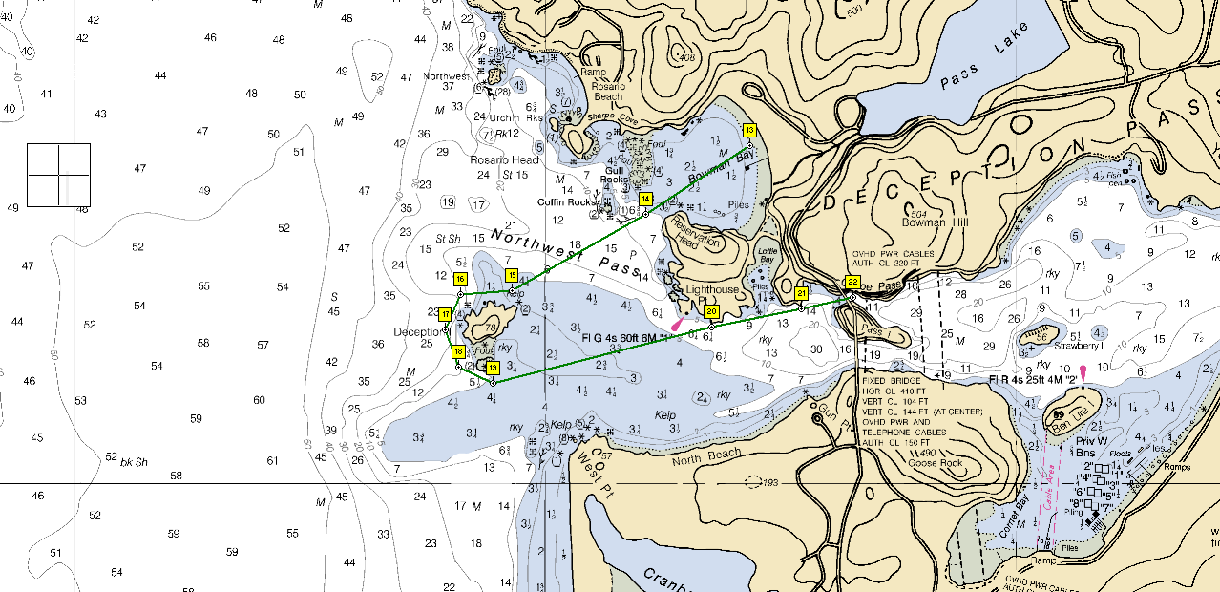
Rate the trip: Deception Pass
Crossing distance is ¾ mile.
Wind is calm.
Current is ebbing at 6.5 knots in Canoe Pass.

Slide 46
Bottom Line
Use the OOPS Trip level and skill matrices to help select and plan trips
  It doesn’t hurt to be conservative setting the overall level
These are useful tools for private trips too!
Watch out for paddles with beginners or the possibility of rapidly changing conditions
Know your safe-havens and bail-out options

Slide 47
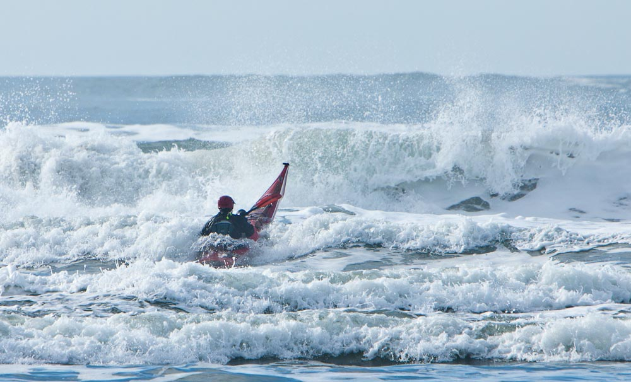
Agenda
Goals
Logistics and Legal
Trip Planning
  Trip Levels, Skills
  Conditions
  Safety & Risk Assessment
  Medical Issues
Group and Incident management

Slide 48
Conditions
Here in the Pacific Northwest, we need to consider at least some of the following before and during every paddle (including level 1). All paddlers should come to the launch with relevant information in-hand:
Weather, especially winds
Water Temperature
River conditions (temperatures, currents, flow rates)
Tidal Factors – Height and Currents
Swell & Surf
Possible Landings
Your one-stop-shop: https://oopskayak.org/onlinepaddlingresources

Slide 49
Weather – NOAA, Wunderground, Sailflow, darksky, Windy, VHF Radio
Dealing with weather is simple … always check forecasts and know your limits.
It’s the wind that matters most. Key issues for understanding wind:
  Direction: Stated in terms of where the wind comes from (opposite of the convention with current).
  Fetch: the span of water the wind blows over. Longer equals bigger waves
  Time: How long has the wind been blowing? The longer the more waves will develop
Fog, thunderstorms, precipitation can also have a big impact on your trip
And don’t forget the air temperature and humidity
Pay attention to how all these vary during the day
Any wind over 25 knots (29 mph) is very tough! Only advanced paddlers working in well practiced teams should choose to paddle beyond 30 knots (35 mph)… and even then, you better hope you’re heading downwind!

Slide 50
Wind Waves
Fetch: The unobstructed distance of water passed over by the wind
The longer the fetch, the bigger the wind waves
  This may change as your trip processes (opposite ends of a lake)
The bigger the wind waves, the more impact they will have on your progress
If the waves are tall enough, your boat gets pushed by the wind on the top of the wave, and left alone at the bottom
  Making keeping your direction challenging
Wind waves can be a bigger deal than swell – their period tends to be shorter, giving you less time to react between waves

Slide 51
Managing a group in the wind
Paddle as a reasonably tight blob
  With the slowest paddler in the center
  Leader on the downwind leading edge to set the angle of the paddle and catch boats
Gorge Run
  Organizer in back to get the swimmers, boat catcher in the front, plus flankers
  Set up designated meeting points
    People who stick to the sides of the river in gentler conditions will progress faster than those surfing, so designate places for the group to reform before progressing
  If only one leader – do it from the side, and don’t be afraid to raft the group up (good luck getting everyone’s attention)

Slide 52
Wind and Weather
Find out how the wind speed will vary at Stevenson, Washington over the day.
  How about Astoria, Oregon
How about in two days?
BONUS: Looking at synoptic charts, how do you predict the wind direction and strength to change today in Astoria? Now check your results with the NOAA hourly graphs.

Slide 53
River Conditions – NOAA, River Reports, VHF Radio, USGS
Before any river trip, note the height, flow rate, currents, wind direction, tide, and water temperature
  Keep a record of conditions observed after every paddle to fill in the gaps
  USGS reports mean water velocity in feet/second for some stations (1 f/s = 0.6 knots)
Currents make a big difference
  Can speed up or slow down progress
  Can drain or save paddler energy
  3 knot current – stand still at normal paddle speed
  6 knot current – stand still while sprinting
  Tides can speed up or slow down a river

Slide 54
River Conditions cont.
Wind opposing current will stand up wind waves; same direction will calm
  Important particularly on the Columbia
Especially on larger rivers, you can “eddy-hop” to make good progress against the current
Pay special attention to deep and shallow parts of the river, and river obstructions (natural or manmade)
  Magnify/tame waves

Slide 55
Water Temperature – River Reports
Pacific Northwest – rivers are only warm for a few months a year
  It gets warm outside long before the rivers do
  The resulting cold shock is a common reason for drowning on spring days
    Which is why a properly-worn PFD can save a life – see Medical section
If it’s hot out but the water is cold, make sure to keep people in immersion-wear cool, and consider denying people who are not adequately dressed if necessary
  Early rescue practice can be used to give people “the hint” if this is a paddle where immersion or lots of splashing may be likely
Know your limits, and dress for immersion – see website for recommendations
  And insist on a properly closed life jacket at all times

Slide 56
Golden Rules of Cold Water Safety
The 5 Golden Rules of Cold Water Safety are your roadmap through this jungle. While each rule is important in its own right, it's the combination of all five that allows you to build a strong cold water safety net.
1) Always Wear Your PFD
2) Always Dress For The Water Temperature
3) Field-Test Your Gear
4) Swim-Test Your Gear Every Time You Go Out
5) Imagine The Worst That Could Happen and Plan For It

Slide 57
Proper Immersion Wear – Dress for Water
Layer appropriately under drysuit
Don’t forget paddle jacket for lunch breaks or squalls!
No cotton for water below 80!
Wet cotton over a drysuit can keep someone from getting too hot
Water Temperature | Hypothermia / Breathing Risk | Appropriate Clothing
70F and up | Low | Dress for air
55-70 | Moderate | Wetsuit or drysuit required
45-54 | High | Drysuit
Below 45 | Extreme | Drysuit

Slide 58
River Conditions
Use the NOAA website to find the predicted river height of the “Willamette River Above the Falls at Oregon City” in two days
Use the USGS website to find the water speed on the “Willamette at Newberg”
Use http://levels.wkcc.org/ to find the water temperature in the “Clackamas at Estacada”

Slide 59
Tidal Factors – Height and Currents – NOAA, Tidespy, Protides, Deepzoom
Tides affect most of the lower Columbia and Willamette Rivers
  They modify the river currents and heights
  They can create navigational hazards (tide races, inaccessible turns)
Tides at the coast have a big influence on when/where we can launch and explore
They also can amplify rip currents and currents parallel to the shore (created by the return of the surf water to the deep ocean)
You can estimate the water height at a given time using the Rule of 12ths
  If it takes 6 hours to go from low to high tide, the water level will be at 25% after 2 hours, at 50% after 3 hours, and at 75% after 4 hours

Slide 60
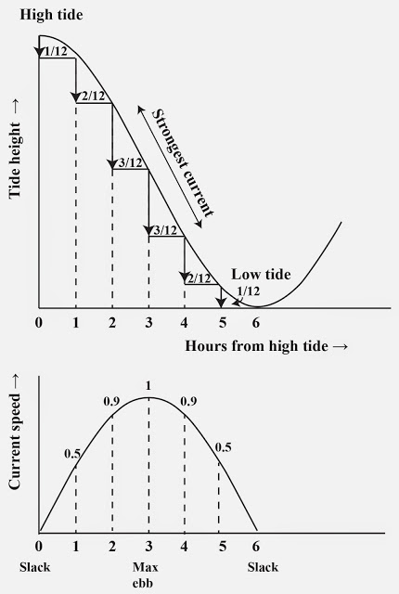
Tidal Currents - Rule of thirds
(50/90 rule)
The NOAA tables provide times for slack and peak.
Use the rule of thirds to estimate current at other times:
  Divide time from peak to slack into three equal segments (~1 hr)
  Slack to peak
    50% of peak after 1st segment
    90% of peak after 2nd segment
    100% (peak) after 3rd segment
  From peak to slack
    90% of peak after 1st segment
    50% of peak after 2nd segment
    0% (slack) after 3rd segment
This rule interpolates abs(cos(n*pi/12)) for n = 0 to 12. it comes from David Burch, Fundamentals of kayak Navigation, 1987

Slide 61
Estimating Tides: The rule of 12ths
Tide varies from low to high (and back again) according to a smooth curve called a sine wave.
The rule of 12th’s approximates a quarter sine wave
  Divide time from low to high tide into six segments (~ one hour segments).
  The change after each segment (hour) expressed as a fraction of 12:
First hour | 1/12
Second hour | +2/12
Third hour | +3/12
Fourth hour | +3/12
Fifth hour | +2/12
Sixth hour | +1/12
High tide
Low tide
Restating: If it takes 6 hours to go from low to high tide, the water level will be at 25% after 2 hours, at 50% after 3 hours, and at 75% after 4 hours
Notes:
cos (-pi) =

Slide 62
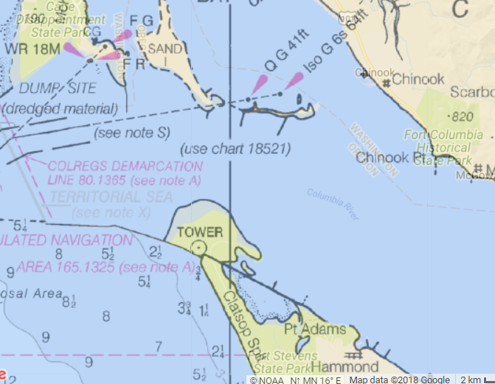
Crossings in current discussion - Clatsop Spit to Sand Island
When crossing a channel in current, the current will flush you along the channel as you cross.
Consider the 1.5 nm crossing from Clatsop spit, OR to Sand island, WA at the mouth of the Columbia with a 2 knot ebb current (assume constant current, no wind)
How do you get across?
2 kt ebb
1.5 nm
Get high and stay high!

Slide 63
Tides and Currents
What are high and low tides at Garibaldi?
What are the current predictions for “Hunting Island, south of (PCT1216) Depth 20 ft” (hint: Washington at the mouth of the Columbia)
What are the current predictions for the Tillamook Bay Entrance?
BONUS: What currents and tides can you expect at Brookfield (formerly Jim Crow) Point today? (hint – need to interpolate between two tide stations)

Slide 64
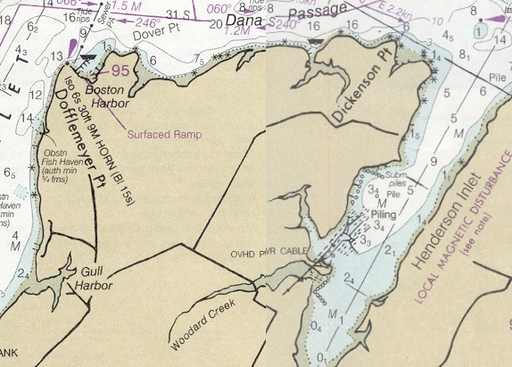
Estimating tides:
You are leading a group of paddlers to explore the Woodard Creek estuary. You know that:
  From past experience, it is all mud at a 1 ft tide.
  Tide data: high 9’ at noon, low 0’ at 6 PM.
What time must you turn the group around to avoid the mud?
1 nm

Slide 65
Using the rule of 12ths to estimate “turn-around” time
Assume:
  Tide data: high 9’ at noon, 0’ at 6 PM.
  It is all mud at a 1 ft tide.
  You want 2’ min depth to avoid bottom drag
  Group paddles at three knots
Working from low tide
  Divide tide range by 12
    9 ft / 12 = ¾ ft
  Desired min depth is 3ft (2ft + mud depth of 1ft)
  Convert min tide into “12ths”
    3ft / (¾ft per segment) = 4 segments
  By the rule of 12ths, you get to 4 segments in 2 1/3 hr or the group must be out 2 1/3 hr before 6PM or 3:40 PM.
Working from high tide to get a rough sense
  6.75 feet at 2pm (9ft – 3 * 3/4ft)
  4.5 feet at 3pm (9ft - 6 * 3/4ft)
  2.25 feet at 4pm (9ft – 9 * 3/4ft)
Group paddles at 3 knots, so 20 mins to go 1 nm and get out.
So: turn around no later than 3:20 PM
First hour | 1/12
Second hour | +2/12
Third hour | +3/12
Fourth hour | +3/12
Fifth hour | +2/12
Sixth hour | +1/12
1 nm
Do these calculations ahead of time!

Slide 66
Swell & Surf – NOAA, Magicseaweed, VHF Radio
Swell is the collection of waves moving away from a storm in the ocean.
  Pay attention to the direction
Swell height is an average of the largest 1/3rd of all waves
  1 in 100 (1 every ~15 min) will be 1.5x this, 1 in 1000 (1 every ~2.8 hours) will be 2x this
Swell period is literally the time it takes for successive waves to pass the same point in seconds.
  Practically, the peak period of a swell gives a great idea of how powerful the swell is and the size of the surf it will create

Slide 67
Swell & Surf – NOAA, Magicseaweed, VHF Radio
Doubling the period gives about a 50% increase in the height of the breaking waves from the same sized swell (and *much* more power to the waves – there is more water in each wave).
  4ft @ 10 seconds = 6ft breaking waves; 4ft @ 20 seconds = 9ft breaking waves
The increase in wave height begins to occur at depths of around one half of the wavelength.
In general, a wave will start to break when it reaches a water depth of 1.3 times the wave height.
The steeper the beach, the bigger the waves

Slide 68
Guessing the size of breaking waves
Use the larger of:
Half the swell period in seconds, converted to feet
Combine the height of the swell and wind waves and multiply by 1.3
Example:
  We have 4-foot swell with a 16-second period, and 1-foot wind waves
  By formula 1, waves with a 16-second period could result in 8-foot breakers
  By formula 2, 4-foot swell plus 1-foot wind waves times 1.3 gives (4+1)*1.3=6.5-foot breakers
  So it’s going to be a big day. Take out the camera, not the boat

Slide 69
Swell and Surf
What is the surf going to be like at Lincoln City in two days? What swells make it up, and what will the wind be doing as the day progresses?
What is the NOAA Marine forecast for offshore of Lincoln City at the same time?

Slide 70
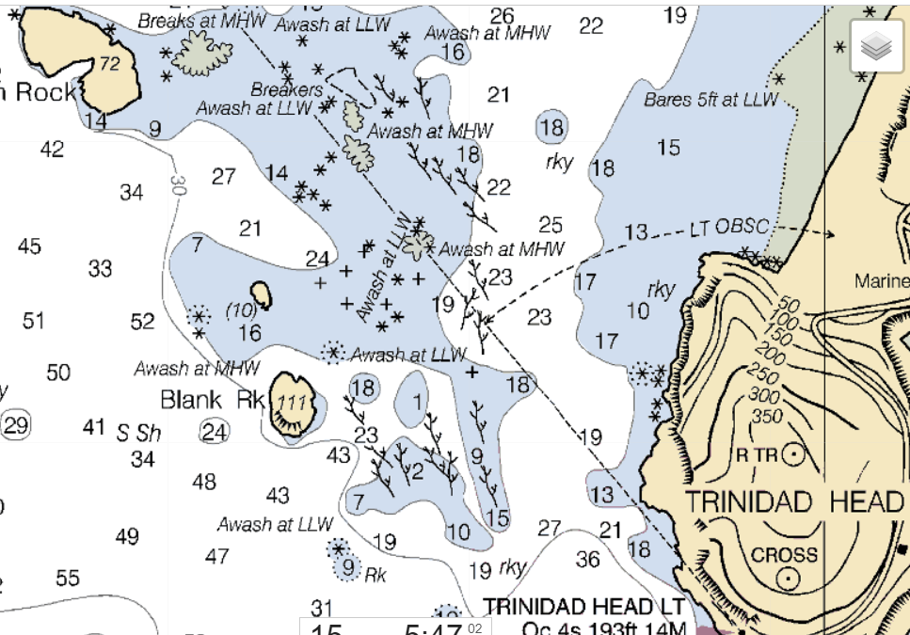
Managing a Group in Boomers/Rock Gardens
Use people as buoys to paddle around (to avoid hazards)
Move people from safe-zone to safe-zone
Always keep an eye to the sea for the next set/sneaker wave
Take. Your. Time.

Slide 71
Managing a group in the Surf Zone
Land everyone, starting with an experienced person to tell those coming in to hold, move forward, etc. and another person with the group to sequence people in
  Weaker people first is one strategy
Once everyone on shore, debrief
Then consider releasing those people who want to go out to play some more
Make sure the surfing circuit is agreed upon and fully understood before they launch
Set a time when the group needs to move on to its next activity, and players need to agree to come in when they get the signal

Slide 72
Conditions and Trip planning (OOPS or personal)
Weeks or months before:
  Talk to people who have been to the location before, post questions on the listserv or Facebook, and look at https://www.oopskayak.org/location-information and on https://oopskayak.org/Location-Information-Forum
  Look up average air temperatures, guess water temperatures
  Sunrise, sunset, possible landings
  Tides & currents
  If the idea looks reasonable, submit your trip proposal
1 Week before the trip:
  Start checking weather forecasts, especially wind
  Check currents forecasts, water flow if applicable
  Check surf and swell forecasts

Slide 73
Conditions and Trip planning (OOPS or personal)
2 days before:
  Go/no-go based on weather, wind, currents, flow rates, surf, and swell
Day before and Morning of:
  Continue to check weather, wind, currents, flow rates, surf, and swell and switch to Plan B if necessary
  Write down pertinent information on your boat (tides, weather, etc.)
The Day After:
  Document on Facebook and at https://oopskayak.org/Location-Information-Forum for the next person
  File your trip report

Slide 74
Bottom Line
Don’t be surprised by what you experience during the paddle!
  At least what can be predicted by available evidence
  Pay attention to the conditions at the end of the day as well as at the start
There are plenty of resources – no excuses
  Double-check with other participants – does everyone agree with what to expect?
Everyone needs to do this homework

Slide 75
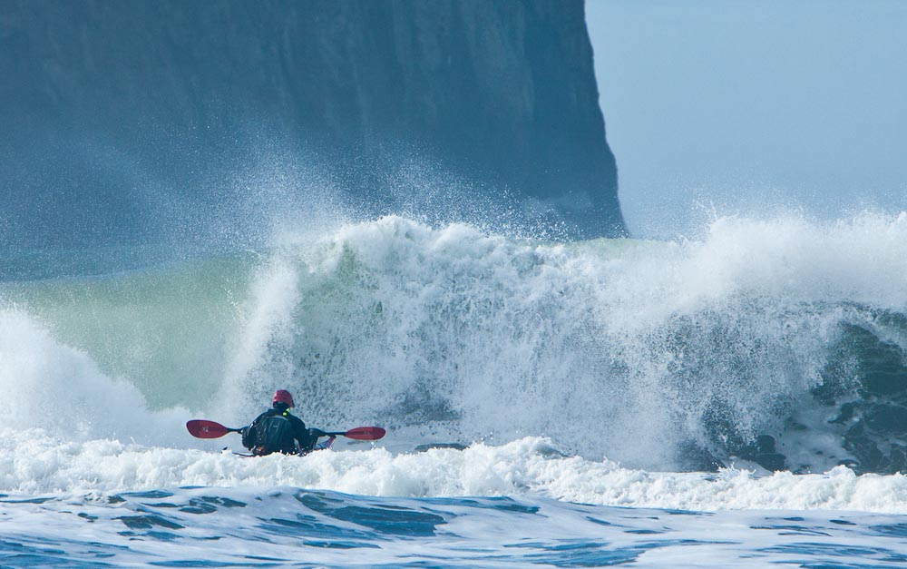
Agenda
Goals
Logistics and Legal
Trip Planning
  Trip Levels, Skills
  Conditions
  Safety & Risk Assessment
  Medical Issues
Group and Incident management

Slide 76
Safety: general principles
Everybody is responsible for safety: but the trip organizer has additional considerations.
Three key principles
  Hazards: Anticipate and avoid them, but don’t assume you can always avoid hazards … be prepared to deal with them.
  Risk Assessment … have a system to quickly assess risks and keep updating your assessment as the trip unfolds.
  Medical emergencies … Understand the most common medical emergencies OOPS members are likely to face and be ready.
All of this applies to private paddles as well as club paddles

Slide 77
But First, for everyone’s peace of mind
Before you go out, tell someone where you are going, and when you will be back. Call if you are going to be late, and make sure your phone is on.
For more elaborate trips, file a float plan
Float plans
  Electronic Float Plan with State of Oregon: http://www.oregon.gov/OSMB/forms-library/Pages/Float-Plan.aspx
  Official Coast Guard Float Plan: http://floatplancentral.cgaux.org/

Slide 78
Risk Assessment: Keep it simple
There are many systems out there:
  NOLS
  Body Boat Blade
  PEG: People, Environment, Gear
  BBC: Bodies, Boats (and equipment), Conditions
  The Mother Principle (worst case scenario analysis)
Pro Tip: These Assessment Systems are also good planning checklists
The key is to have a system that helps you remember ALL the key issues you need to consider.
Find one that works for you … and use it
  Before the trip
  At the put-in
  Throughout the day

Slide 79
Example: Risk Management Triangle
Assign stop-lights to each side of the triangle based on risk relative to the conditions inside the triangle.
All green is “good to go”. Red is “no-go”. Yellow is “proceed with caution”
Swell, period & size
River levels
Water temp
Current
Tide
gear
Wind
Temperature
Precipitation
Fog
People
Atmosphere
Sea
skills
health
Communication
Attitude
Pressures and goals
Assign red, green or yellow to each side of the triangle
Context
Shore, sand, rock
Boat traffic
Bailout options
Accessibility to emergency services
Source: NOLS, www.nols.edu

Slide 80
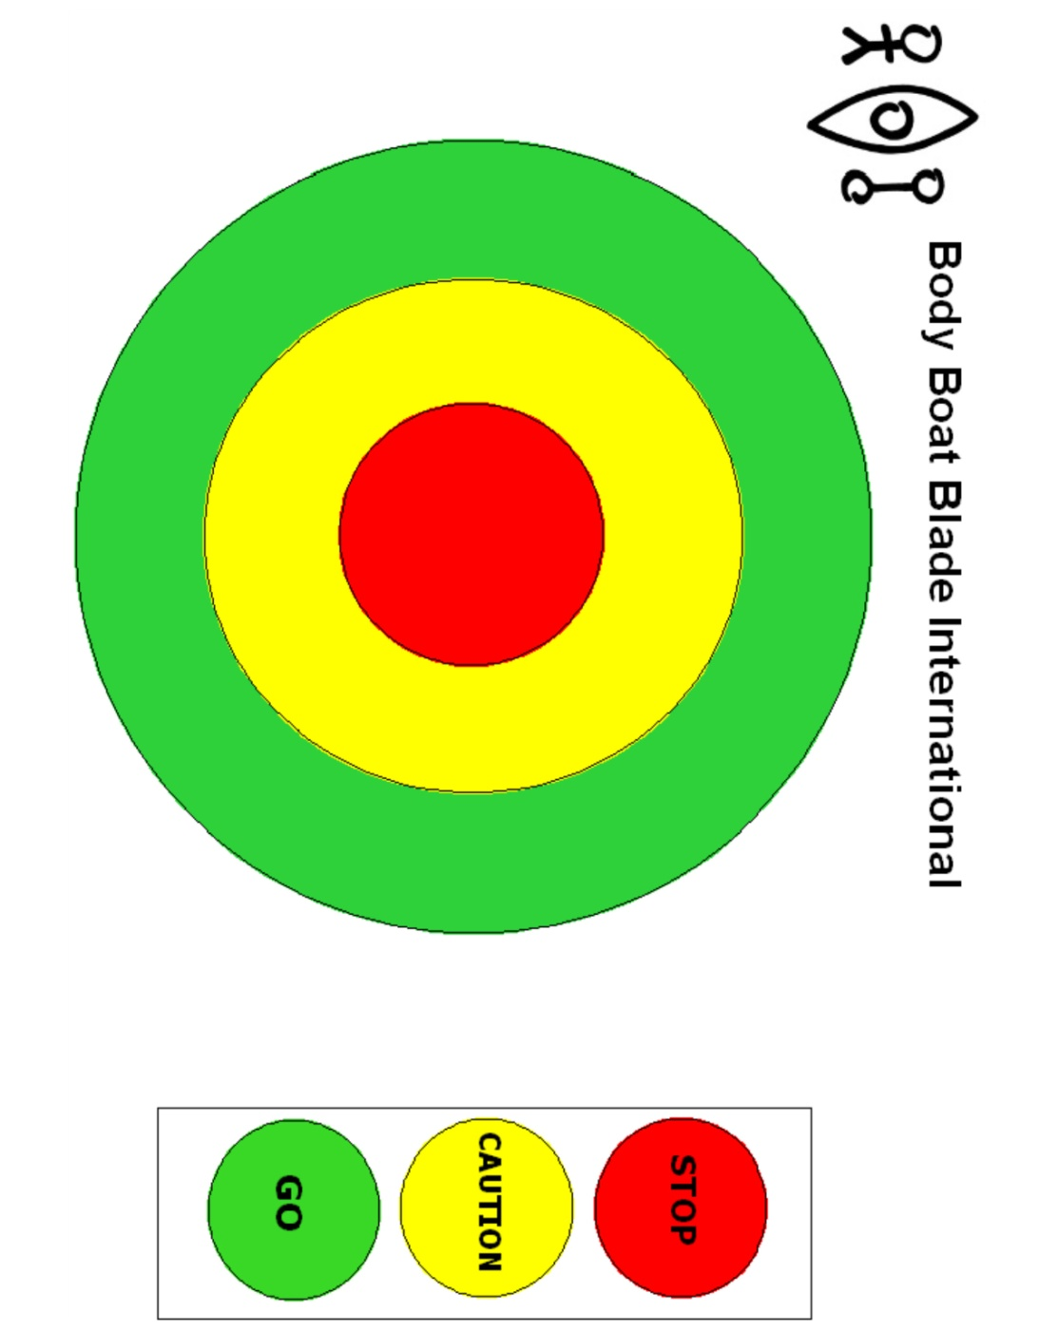
Example: The BBB Risk Assessment Bulls-eye
Create a check list of risk factors (see next slide).
Evaluate group relative to each category
Place a mark for each category
  Green: go
  Yellow: caution
  Red: no-go
A bulls-eye with a bunch of red marks would be an obvious no go situation.
One with lots of green and a couple of yellows might be a go.
The Body Boat Blade Safety Bulls-eye
Source: Body Boat Blade International
Notes:
WEATHER
BIG PICTURE - SYNOPSIS
Improving
Worsening
WIND
Speed
Now / Later
Direction
Now / Later
On Shore
Off Shore
Relation to currents
RAIN / SUN
Temperature
Psychology
VISIBILITY
Fog
Night/Dusk
THUNDERSTORMS
OTHER HAZARDS
LAND
LANDSCAPE
Terrain
Remoteness
OUTS
Roads
Help?
LANDINGS
Swell
Beach Type
Tide
WILDLIFE
OTHER HAZARDS
OTHER FACTORS
Sunset / Sunrise Time
WATER
SWELL
Size
Period
Direction
WIND WAVES
On Shore
Off Shore
In relation to Currents
TIDES
High
Low
Range
Relation to off shore boomers
Relation to on shore break
CURRENTS
Speed
Direction
Relation to wind waves
Relation to Swell
Relation to Races and Over falls
BOAT TRAFFIC AND SHIPPING
OTHER HAZARDS
GROUPS
LEADER/S (Know your limits – 5 Star assessment)
Walk in Park?
Can you pick up the pieces and or pull the group out?
BEHAVIOUR OF INDIVIDUALS IN FORECAST CONDITIONS
STRENGTH
Physical
Mental
Skills
PERSONAL EQUIPMENT OF GROUP
Body
Boat
Safety
Visibility
HEALTH CONCERNS

Slide 81
Risk Analysis: The BBB Check list
Weather
  Big picture
    improving, same, degrading
  Wind
    Speed … now and later
    Direction … now and later
    Off-shore or on-shore
    Relation to currents
  Rain/Sun
    Temperature
    Psychology
  Visibility
    Fog
    Night/Dusk
Land
  Outs
    Terrain
    Remoteness
    Roads
    Help
  Landings
    Swell
    Beach type
    Tide
  Other hazards
Water
  Swell
    Size
    Period
    direction
  Tides
    High, low, range
    Relation to off shore boomers
    Relation to on-shore break
  Currents
    Speed and direction
    Relation to wind, swell
    Tide races and overfalls
  Boat traffic and shipping
  Other hazards
Groups
  Leader/s
    Walk in park?
    Can you pick up the pieces and/or pull the group out?
  Behavior of individuals in forecast conditions
  Strength
    Physical
    Mental
    skills
  Personal equipment of group
    Body
    Boat
    Safety
  Health concerns
Other Factors
    Time of day
    Sunset/sunrise times
5 Categories: Weather, Land, Water, Group, Other Factors.
Evaluate each and record results (go, no-go, caution) on the bulls-eye

Slide 82
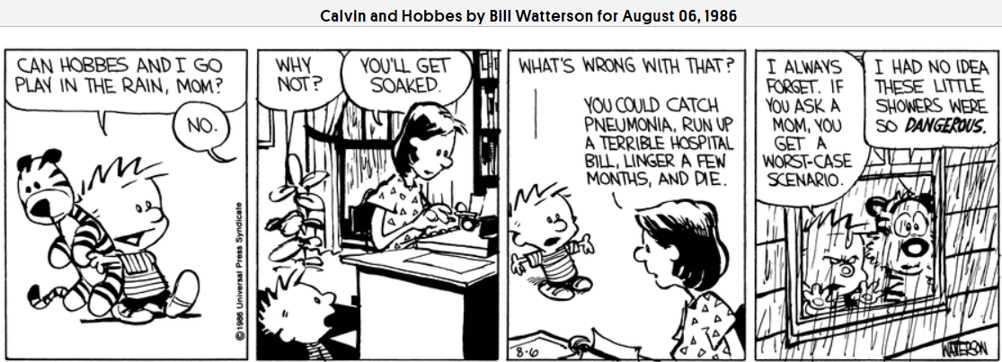
Example: “Mother Principle” Risk Assessment
Understand “worst case scenarios” and make sure the group can deal with them at any given time
Continually assess the situations/group through the trip…always noting the “worst case” scenario “of the moment” and making sure the group can avoid it or at least manage it.

Slide 83
Some Hazards you are likely to face locally
Wind, Waves, Current, Weather
Rocks, sticks, wreckage (sticking up and under the surface)
Bridges – junk caught against footings, eddies behind
Strainers (downed trees) – water goes through, boaters do not
Piers/wing dams – human-made strainers
Dams – “hydraulic” at bottom pulls things back under water; escape by swimming down to the bottom
Boat Traffic
Tidal Shallows that can strand you for 12 hours (Sauvie Island, Willapa Bay)

Slide 84
Exercise
If there is time
Use one of these systems to rate the risk involved in a trip to Jetty “A” from the Cape Disappointment State Park Boat Ramp or Waikiki Beach today

Slide 85
Your brain on the outdoors
Adapted from: http://blog.stansport.com/how-the-outdoors-will-trap-your-brain-part-1/ and http://blog.stansport.com/how-the-outdoors-will-trap-your-brain-part-2/
Except in the earliest stages of learning a skill, your brain does not “assess the situation”, “brainstorm alternatives”, “develop a plan”, “execute the plan,” and “evaluate”.
  This type of analysis takes a lot of time and requires a lot of information.
  When a possible threat is present (saber tooth tiger), this can kill you

Slide 86
Rules-of-Thumb – domain-specific heuristics
Your brain takes shortcuts, especially when under pressure, or if the situation is fluid: your brain robs energy from the reasoning part of your brain to power hyper-alertness and reflexes:
  You literally don’t have the brains for complex reasoning and detailed plans
So we use rules of thumb
  “No less than three, go to sea”
  “Always look towards the sea”
  “be off the water by 2pm” (due to winds)
  “Measure twice, cut once”
  “Don’t paddle at the mouth of Netarts Bay during the ebb tide”

Slide 87
Heuristic Traps
Heuristic: an approach to problem solving that is not guaranteed to be optimal or perfect, but is sufficient for immediate goals. Mental shortcuts that ease the cognitive load of making a decision (Wikipedia)
Problem: When a rule of thumb gives us a grossly inaccurate perception of a hazard, we fall into what are known as a “heuristic traps”:
  Situations where even trained people repeatedly ignore obvious clues to danger and proceed when the signs are screaming at them to scout, stop, or turn back
  They focus on one aspect of a challenge to the exclusion of all others

Slide 88
Decision-Making Traps with Big Consequences
Rules of thumb/“heuristic traps” that give us a grossly inaccurate perception of a hazard
Scarcity Trap: "I've driven 3 hours to get here, so I'm going to launch no matter what the conditions are! “
False Familiarity Trap: “I was down this river last fall, so I don’t need to scout the next corner this spring“
Expert Trap: "Sean is a very experienced paddler, he would never take us to a hazardous place“ (e.g. "Don't let your leader lead you to your death!“ or “Your leader may be falling into another trap”)

Slide 89
Decision-Making Traps with Big Consequences
Rules of thumb that give us a grossly inaccurate perception of a hazard
Ego Trap: "Well, if Sam made it through that rapid, then certainly I can make it through too“
Social Pressure Trap: “Joe and Patty have already made it through the big surf. I guess I’ll go ahead and launch -- I don’t want to look like a wimp”
Momentum/Laziness Trap: “Tom and Paul are here, and have already taken their boats off their cars -- let’s go ahead and launch anyway”
With your mind focused on one of these traps, you literally don’t have the brain power to think of the big picture – fight or flight again
Much more on this: Read "Decision making for wilderness leaders: strategies, traps and teaching methods" and "Heuristic Traps in Recreational Avalanche Accidents: Evidence and Implications," both by Ian McCammon, Ph.D.

Slide 90
A different type of trap: Risk Creep
Humans are terrible at recognizing slow change.
Our brains are poorly equipped to recognize when we are slowly getting too tired, too cold, or too close to the edge of our abilities.
Combat this with triggers, cut-offs, and turn back times.
Examples: rising river levels, wind in the gorge, larger swell or period on a specific beach
  How high is too high? How much wind is too much in the middle of the channel?
  How do you know what your limits are?
  “Solution”: We use our own or our collective knowledge to establish limits for ourselves. When spring flow hits a certain cms/cfs, the wind a specific speed, the swell a particular size for a given period, we find somewhere else to go.
Alternative learning strategy: make the easy hard (ex. paddle a kayak with a canoe paddle on flat water, paddle backwards, learn to kayak sail) rather than constantly pushing against our ability in more and more extreme conditions

Slide 91
Exercise
Give an example where you fell into one of the decision-making traps
Charles:
  canoeing snake river with n00bs as a n00b
  end of trip, take off without consulting leader to surf a few wind waves back to the take-out – playing with a person that weighs half as much and is faster
  Car loaded, in dry suit, pull out into rain to load boats onto car, decide not to paddle
Mel: Aldrich Point to Skamokawa and run out of daylight

Slide 92
Avoiding Decision-Making Traps 1
Be Vigilant
  Work hard to note when you, or those you are with, start falling into these traps
Absence of Evidence is not Evidence of Absence
  Just because you ignored the warning signs and got home safe, doesn’t mean the risk wasn’t there (see “Reflection” coming up)
  You got lucky
  Remember Dirty Harry: "Did he fire six shots or only five?“… you've gotta ask yourself one question: "Do I feel lucky?" “Well, do ya, punk?”
Reassess
  Regularly reassess your plan and the risk during the trip. Your inclination will be to continue on. Should you? Really? Pay attention to your gut – it’s OK to say “No”

Slide 93
Avoiding Decision-Making Traps 2
What people in high-stress professions (firefighters, mountain rescue, Coast Guard) do to avoid the traps is replace rules-of-thumb with “recognition-primed decision-making”
  Recognizing a situation from a distinct set of clues
  Respond based on a large database of scenarios, training, practice, and experience
  Done properly, can become quick and intuitive (and save a life)
  Not based (mostly) on someone dying

Slide 94
Recognition-primed decision-making
Always put on your turnouts on in the same way
Always connect to the hydrant the same way
Always report on a car crash or fire the same way when you arrive on-scene
  Then respond using the template of previous training
Always give the same information, in the same order, during a MAYDAY call
  Then make yourself easy to find using techniques learned during training
Always do 4 things after forcing a door
Stage uphill and upwind from a hazmat incident, establish hot, warm, cold zones based on wind direction and speed (it’s written down)

Slide 95
Avoiding Decision-Making Traps 3
How to build this experience:
Reflection:
  Figure out why things went well. How? Can you repeat? Did risks exist that never came to a head? Debrief each other.
    Be honest with yourself: If you had a perfect trip, reflect: did you pass any snags, wing dams, fishermen, power boats, etc.? Did the group get spread out/some people out of sight for a while? Were people well-positioned and able to help if something had gone wrong?
  Figure out what went wrong. Go beyond the simple answers
Do Mental Exercises – Paper Scenarios
Conduct “real” scenarios
Keep a logbook with all these observations, plus conditions (flows, tides, weather, who was there, etc.)
  Forecast, actual conditions, anything notable observed about (conditions, places, people), what happened, etc.

Slide 96
Avoiding Decision-Making Traps 4
How to build this experience cont.
Conduct a Pre-Mortem with the entire group
  Imagine that your plan was implemented as you intended but it still failed. Why? What could cause this (unexpected weather, bear at proposed takeout, etc.)
  Imagine that the easy parts of your plan went fine, but the challenging parts were a mixed bag. What happens to the rest of your plan if you miss a key crossing at slack tide?
  Pre-Mortems help you spot weaknesses in your plan, and expose unknowns
Prediction, Experience, and Reflection accelerate the process of recognizing key patterns
Read and discuss with others lessons from “Deep Trouble” books
  See also the “OODA Loop” – Observe, Orient, Decide, Act

Slide 97
Getting honest feedback – watch out for peer pressure
Everyone assesses risk on their own. But you also need to understand the group perception of risk:
  Everyone on the trip must support the group’s plan. An apprehensive or nervous paddler is not only unhappy, they are tense and in a potentially dangerous state
When discussing risk as a group, people may hide their true feelings out of fear of what others think or of being responsible for a “no/no-go” decision that denies others a “fun” day of paddling.
Getting honest feedback without peer pressure
  Talk to people individually in private
  Everyone in line with hand behind their back and eyes closed. Show happiness/comfort to leader via number of fingers or thumbs up or down
    Eyes closed only also works on the water

Slide 98
Managing the siren call of heuristics
Don’t take boats off of cars until the group has honestly assessed the conditions (anonymous votes recommended)
Come with a Plan B (and maybe C)
Reassess frequently throughout the trip. Be honest with yourself
Make reassessment a shared responsibility of the entire group. Again, anonymous votes (or simply exaggerating the silent vote) might be a way to allow people who are out of their depth but afraid to say so to bring some sense into the group).
  Pay attention to the other paddlers – who is beginning to look/act differently?
Act early (don’t decide to pull the plug when in the middle of a 40kt headwind!)
Trust your gut: it’s OK to say “no”
Paul Kuthe: “Some of my best days paddling have been on the beach”

Slide 99
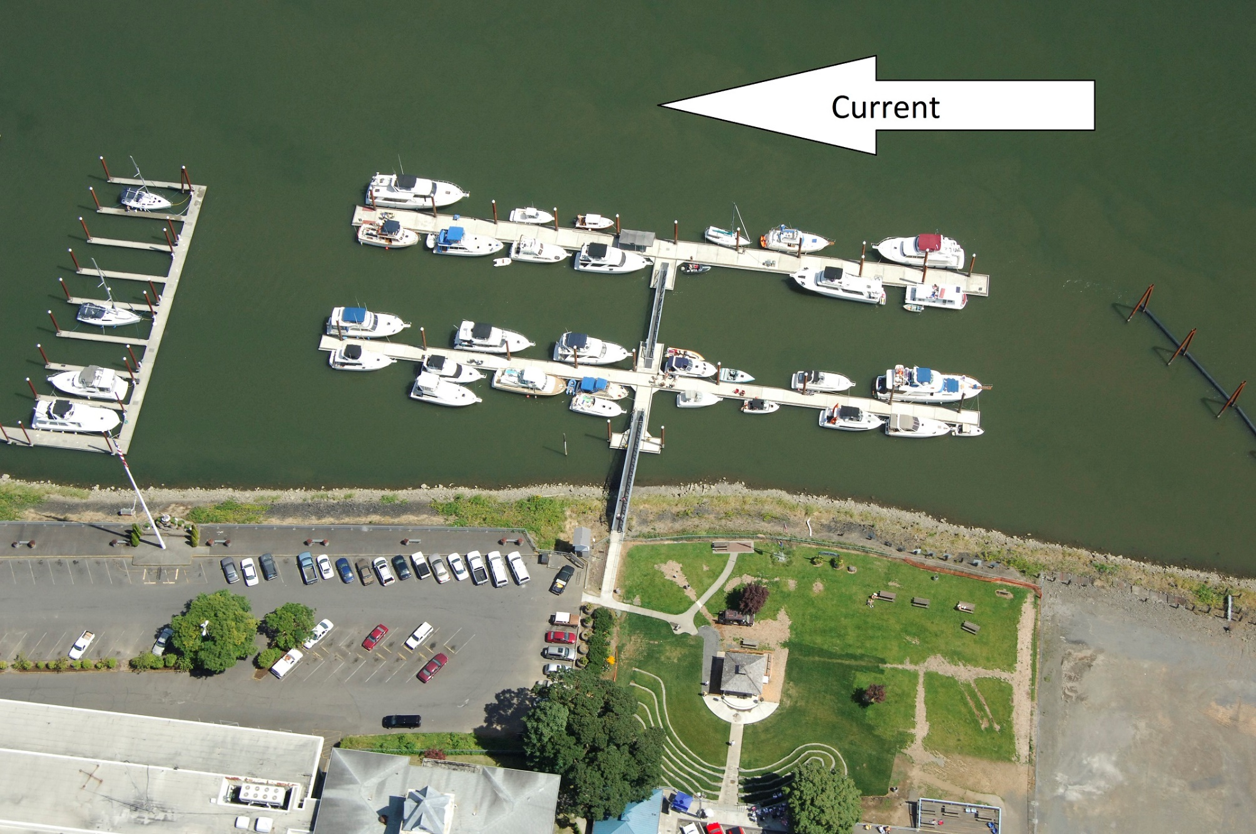
Pattern Recognition Exercise
St. Helens public boat ramp
You are returning from a long day’s paddle. Where along the dock do you tell people to get out (it’s about 2-3 feet from the water surface to the walkway on the ramp)?
Why?
Where should they not get out?
Why?

Slide 100
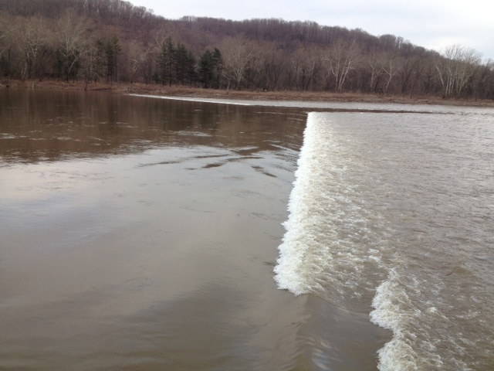
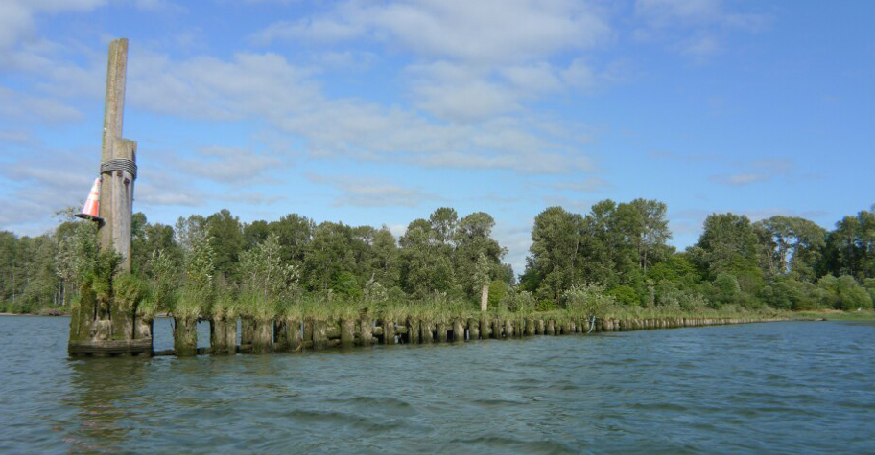
What’s a Wing Dam?
Answer: a drowning machine
They look something like this:
High water
Low water

Slide 101
Pattern Recognition Exercises
A paddler is floating sideways towards a wing dam or downed tree and cannot get away. What should they do?
A paddler gets stuck on a wing dam or downed tree and is still right-side up. What do you do to rescue her?
A paddler flips approaching a hazard. There isn’t enough time to get them back into their boat, but there might be time to do something else…

Slide 102
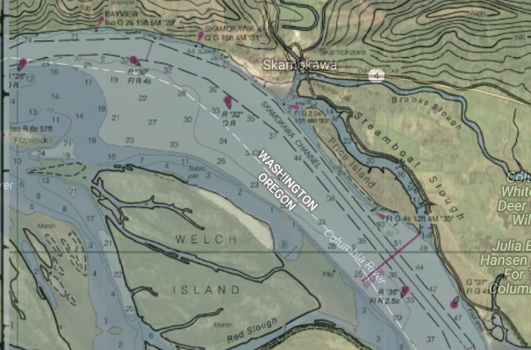
Pattern Recognition Exercise
It’s the OOPS Skamokawa weekend. Your group is coming around from behind Welch Island when dense fog hits. From either location:
How do you find your way back to town?
How do you cross the shipping channel?
Thinking out these things ahead of time is one of the reasons the organizer asks participants about possible hazards before starting the paddle

Slide 103
Remember
Reevaluate Risk from the time you enter the parking lot until you get home again.
Use a system that works for you on and off the water
Red Flag: it looked good when you left home, but it’s bad when you get to the put-in
  If you did your homework this isn’t a surprise…usually
  Sometimes local knowledge can supersede forecasts
Constantly stay alert to changes on the water
Wind may make getting boats on cars dangerous
If people are really beat, don’t let them drive home without some food and rest

Slide 104
Some things to consider when paddling in the Portland Area
Dressing for water temperature (typical water temps for different times of the year and locations)
Boater’s right away / shipping and small-boat traffic (worst congestion areas, etc.)
  Avoid the Willamette downtown on a hot day
Wing dams and bridges - what they look like, what to avoid, what to do if you can’t
Winds tend to rise in the Gorge, on Willamette, at coast in the afternoon
Tides and mud flats (Sauvie Island, Scappoose Bay)
Fines if you don’t have your Invasive Specifies Permit or Sauvie Island pass
Water cleanliness / where to check for warnings esp. for the Willamette River
When the rivers are flowing too fast
Hunting Season, off-limits areas/times of year for wildlife refuges
Sometimes you get ticketed if parking in a trailer spot (even when doubled up)
Some boat ramps are free, some are not, some require a Discover or similar pass

Slide 105
Bottom Line
Know your team and know yourself
Be honest with yourself
What could go wrong, and could you and the group handle it if it did?
Look for “automatic thinking” in yourself and others (rules of thumb, heuristic traps)
  And train to avoid them
The OOPS pre-trip checklist is your last-minute sanity check and chance to gauge the comfort of the group before you get on the water
Continue to re-evaluate when you get on the water

Slide 106
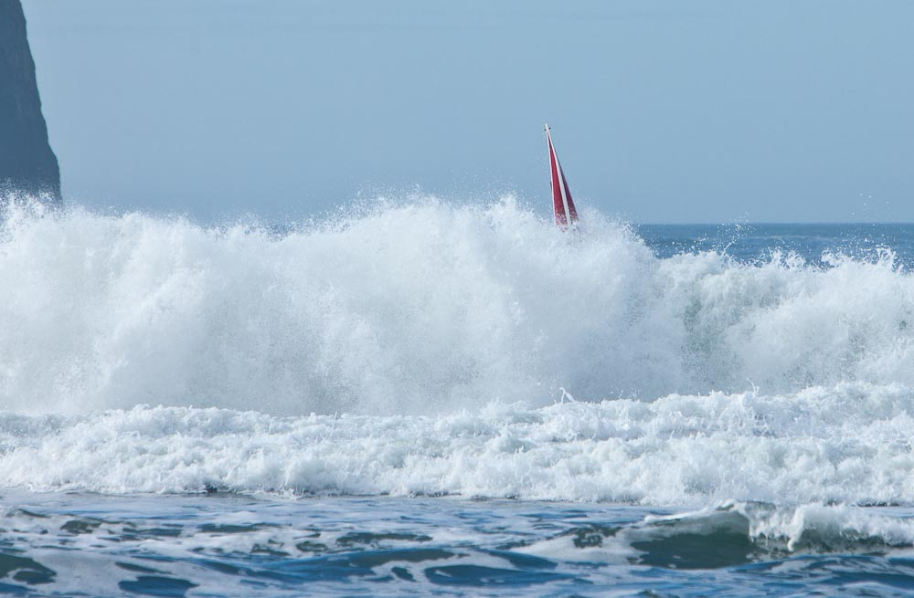
Agenda
Goals
Logistics and Legal
Trip Planning
  Trip Levels, Skills
  Conditions
  Safety & Risk Assessment
  Medical Issues
Group and Incident management

Slide 107
The most Common Medical Issues
Injuries from the car to the put-in
  Including getting into/out of a boat
  To prevent these injuries
    Two+ people carry all boats – builds a team, too
    Hold onto boat if there is a wind when taking on/off car
    Help less-experienced paddlers launch, or get out
Sunburn
Heat and Cold Challenges

Slide 108
Medical Emergencies
Red Cross training is for an Urban environment:
  Professional medical care is minutes away.
  Medical emergencies: Wash your hands, dial 911, know CPR.
Kayaking is more exposed:
  Professional medical care may be hours to days away.
  Medical emergencies: deal with it … you are on your own!
Be prepared for what you might encounter on an OOPS trip:
  Cold water plus wet and stormy weather
  The demographics of our paddlers
    Most OOPS members are middle-aged or beyond
    Most of us are “desk bound” and not as fit as we’d like/should be

Slide 109
The “Most Likely” Medical Emergencies
Some of the more severe issues you may see on a paddle:
Cuts, bruises, strains, breaks
Heat Challenge (Hypothermia/Overheating)
Diabetic Reaction
Heart Issue
Stroke
Anaphylaxis
Sea Sickness/Nausea
Drowning
The Bad News: all of these are higher risk/likelihood in the over-50 crowd (most of OOPS)

Slide 110
For All Medical Issues
Ensure scene safety
Don’t treat the patient while the caregiver or patient are still at risk
  Expand your awareness to the max!
  Don’t increase the number of patients!
The leader should stay apart from treatment
  Or delegate overall group coordination to someone else if the leader the most skilled medical provider present
Don’t make the patient worse
  Watch out for hypothermia while treating/transporting a patient

Slide 111
For All Medical Issues cont.
Biohazards - Take appropriate precautions
If it’s wet, and not yours, don’t let it get on you (goes both ways)
Use Your Eyes first!
Do they look sick? How sick? Is it safe for you to help?

Slide 112
Disclaimer
The following are not a substitute for professional medical training

Slide 113
Patient Assessment 1
Is this person sick? Before touching the patient and while sizing up scene, assess the following:
“Appearance”
  Check the following
    Normal eye contact, muscle tone, behavior, movement? Nausea? Unusual headache? In pain? Unusual anxiety/combativeness?
    Seems to be making sense? Mental state altered, or in distress, or “feeling of doom”
    “Last time I felt this way I was hospitalized for…”
  If the patient’s mental state is altered – medical emergency
    Depending on how they are altered, it could be a heat challenge, stroke, diabetic reaction, sea sickness, heart attack, fear, etc.
    Trip over – try to solve/minimize the problem, aggressively get help/get to help
    Don’t make the patient do anything – keep them rested, calm while others tow, etc.
  Note time when changes first noticed

Slide 114
Patient Assessment 2
Is this person sick? Before touching the patient and while sizing up scene, assess the following:
Breathing – normal breathing is quiet and effortless
  Check the following
    Does it seem to require great effort? Speaking in broken sentences?
    Unusually fast or slow?
    Position of comfort eases breathing (tripoding)?
    What sort of breathing noises?
  No breathing
    Call for help
    Check for obstructions
    Start CPR/breathing for patient
  Labored breathing – medical emergency - trip over
    Check for and administer appropriate medications (asthma/allergy)
    Pull out all the stops to get help/get to help
  Note time when problem first noticed

Slide 115
Patient Assessment 3
Is this person sick? Before touching the patient and while sizing up scene, assess the following:
Circulation
  Check for
    Healthy skin color, or pale, mottled, or bluish? Inappropriate sweating/lack of sweating?
    Signs of trauma or bleeding?
  Trauma/bleeding?
    Aggressively stop severe/prolonged bleeding
    Immobilize damaged parts of body
    Keep clean and get help/get to help
  Skin color/sweat not normal – medical emergency

Slide 116
More quick assessments
Check for 30, 2, “Can-Do”
  Respiration under 30
  Perfusion takes less than 2 seconds (press fingernail or ear lob, release)
  Able to follow simple commands
  Failure of any test is a medical emergency
Radial Pulse and “Can-Do”
  Can you find a pulse on the wrist under thumb?
  Able to follow simple commands?
  Yes to both – get to help but take your time
  No to either or both – medical emergency!

Slide 117
Pop Quiz
39 yo female, sweaty, pale, nauseous, acting odd?
  Heat exhaustion, heart attack, diabetic issues?
65 yo male, looks an odd color and has stopped paddling
  Seasick? Something more? Ask what they are feeling
72 yo female, incoherent, scared, paddling in circles
  Stroke? Or just wigged out?
58 yo male, Altered mental status
  Heart issue, hypo/hyperthermia, diabetic issues, stroke, breathing problems?
54 yo female, Trouble breathing
  Allergy? Choking? Anxiety? Asthma?
What is the definition of “Cold Water”
  Under 70 degrees – Oregon waters for most months of the year
You don’t need to be a doctor to know if someone looks really unusual, or sick - especially if this changes during the trip

Slide 118
Heat Challenges (Hypothermia & Overheating)
In the Pacific Northwest, hypothermia is the most common medical emergency faced by kayakers.
General Issues
  The body starts to malfunction – the patient cannot help themselves
  Easily turns fatal if not addressed
  Don’t swing things too far the other way when treating
  Patients lose heat 25x faster in water than air
Symptoms
  Coming up
Treatment
  Need to immediately remove the challenge and turn things around
    The worse the patient gets, the more fragile they become

Slide 119
Cold Challenge (Hypothermia)
Issues
  Recovery gets exponentially harder the colder the patient gets
  Patients lose heat 25x faster in water than air
  Abrupt movement of a severely hypothermic patient can cause cardiac arrest
  Patient’s mental status degrades
Symptoms
  Normal: Shivering, normal mental state
  Mild: Shivering, pale, and “umbles” (stumble, grumble, mumble – altered mental state)
  Severe: Not shivering, pale, decreased vital signs. Limited consciousness (or totally unconscious).
Treatment
  Remove challenge: Get out of wet clothing, insulate, warm
  Stoke the internal fires: Simple sugars, hydrate (slowly with warm liquids), exercise if safe, heat packs
    Studies show external warming is of limited use and could result in another patient

Slide 120
Hypothermia - Treatment
Normal Cold Response: Easy to “nip in the bud”
  Remove the cold challenge. Dry off, fuel up, exercise.
  Put on additional protective clothing; hot water in boots, gloves, down front
Mild Hypothermia: Immediate action is needed, but you can still fix this in the field.
  Remove the cold challenge. Get them dry, insulated, fueled and active. Warm drinks, chemical heat packs (on the chest, armpits and groin), water bottles full of warm drinks and body-to-body contact are all helpful.
Severe Hypothermia: Death is imminent, rapid evacuation is essential – Call for help!
  Severe hypothermia is a very fragile medical state. Rewarming is dangerous and requires specialized equipment. The heart is particularly fragile.
  Stop further cooling and gently transport the victim to medical care. The victim should be transported flat, as this causes the least strain on the heart. Be ready to do CPR

Slide 121
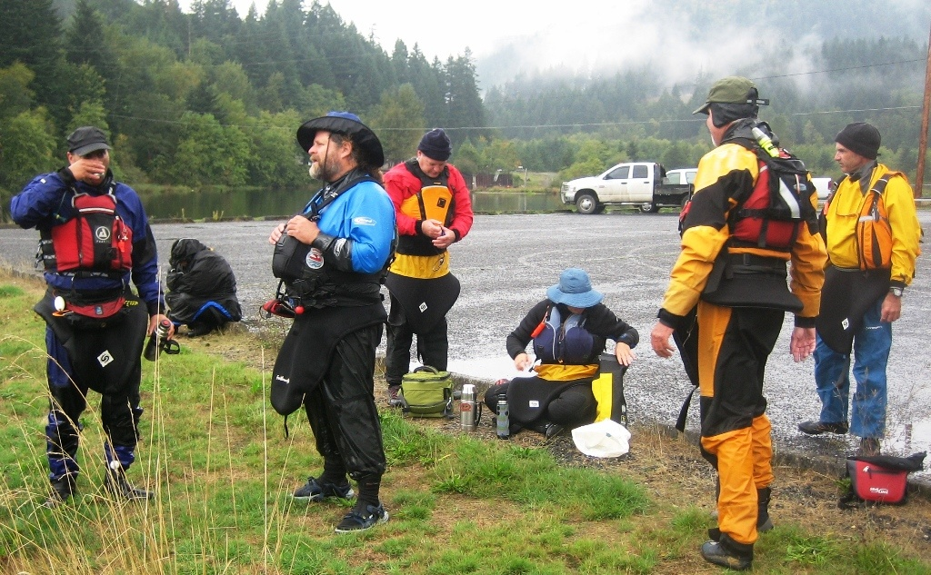
Hypothermia in the field
Be vigilant and watch for paddlers showing symptoms of hypothermia.
Lunch breaks are a particularly vulnerable time …
What’s up with this person?

Slide 122
Heat Challenge (Overheating)
Issues
  Patient’s mental status degrades as temperature approaches/passes 104
  High heat, humidity, dry suits, drinking too much/little can bring on
Symptoms
  Fatigue, weakness, headache, dizziness, nausea, irritability, thirst, cramps, seizure, stop sweating (heat stroke)
Treatment
  Remove challenge: get in shade, stop exercising
  Cool. In the case of heat stroke, aggressively (ice bath, full immersion – caution, patient unable to swim)
    Patients lose heat 25x faster in water than air
  Hydrate slowly with electrolytes (8-15 oz every 15 minutes) – ice chips good

Slide 123
Heat Issues Signs and Symptoms
Signs and Symptoms | Conditions
 | Heat Cramps | Heat Exhaustion | Heat Stroke
Muscle Cramps | Yes | No | No
Breathing | Varies | Normal/elevated, shallow | Elevated, deep -> shallow
Pulse | Varies | Often rapid, weak | Rapid, full
Weakness | Yes | Possible collapse | Collapses
Responsiveness | Normal | Mildly altered, improves with treatment | Very altered, worsens over time to coma
Skin | Moist – Warm, no change | Cold, Clammy | Sweaty or Dry, Flushed or Pale, **Feel Hot**
Perspiration | Heavy | Heavy | Little or None
Internal Temperature | Slightly elevated | Usually below 104F | May be higher than 104F

Slide 124
Other Medical Emergencies
Migraine headaches
  Severe headaches that start with visual disturbances (aura or flashing lights), vertigo, tingling … lasting hours to days
  Not life threatening, but patient probably will not be able to paddle
Shoulder dislocations
  Patient will hold arm in a position to minimize pain
  Stabilize the joint in that position and evaluate (unless you are a WFR and “wilderness protocols” apply … in which case you can reduce the dislocation).
Wounds
  Clean thoroughly and cover with a sterile dressing
Bee stings … life-threatening allergic reactions
  Anaphylactic shock. Ask before the trip if this is an issue. If it is, make sure the person in question has their EpiPen with them and tells you where it is.
Asthma
  Most people self-treat with their inhaler. Patient may be greatly distressed … may need coaching to relax and breathe deeply
Serious medical issues common to older sea kayakers
  Cardiovascular events – emergency evacuation
  Diabetes … patient needs to tell you at the put-in. Carry tube of frosting in your first air kit … if diabetic has problems, treat with frosting followed by substantial food
Sea sickness – paddle over for that person and helpers

Slide 125
Exercise
How would you quickly fix the following issues on the water?
  A cut/blister
    electrical tape
  Low blood sugar/diabetic emergency
    frosting tube
  Mild Hypothermia
    cag, balaclava, sugar candy
  Dehydration
    extra water
  Missing hatch cover
    bungie & plastic; garbage bag/string; inflatable beach ball
  Patch a hole in the hull
    gorilla tape
  Deal with broken paddle
    carry a spare
Write yourself a note now: go home and make sure you can fix all of these issues from supplies you can reach with your spray skirt on

Slide 126
Bottom Line
Speak up if someone looks sick
  You don’t need to be a doctor to tell
  Especially if they look “more sick/suddenly sick” since they showed up at the put-in
Are they “call 911” sick? If so, call for/get to help!
Don’t make them worse, don’t let them get worse if possible
Don’t add to the number of people needing help

Slide 127
Agenda
Goals
Logistics and Legal
Trip Planning
  Trip Levels, Skills
  Conditions
  Safety & Risk Assessment
  Medical Issues
Group and Incident management

Slide 128
What makes a good trip Organizer?
Good trip organizers remember that the reason people have signed up for our trip is to paddle and have fun. It is our job to see that they are successful.
Good organizers try to be inclusive – everyone on the trip needs to have fun
  If someone shows up that is a bad fit, it is your mistake, not theirs. Find a way to make it work if feasible
Good trip organizers strive to continuously improve … Pursue continuing education:
  Paddling skills (strokes, etc.)
  Seamanship, navigation, etc.
  Instructor Training and Certification
You should be able to coach others on how to do something, rather than doing it yourself!

Slide 129
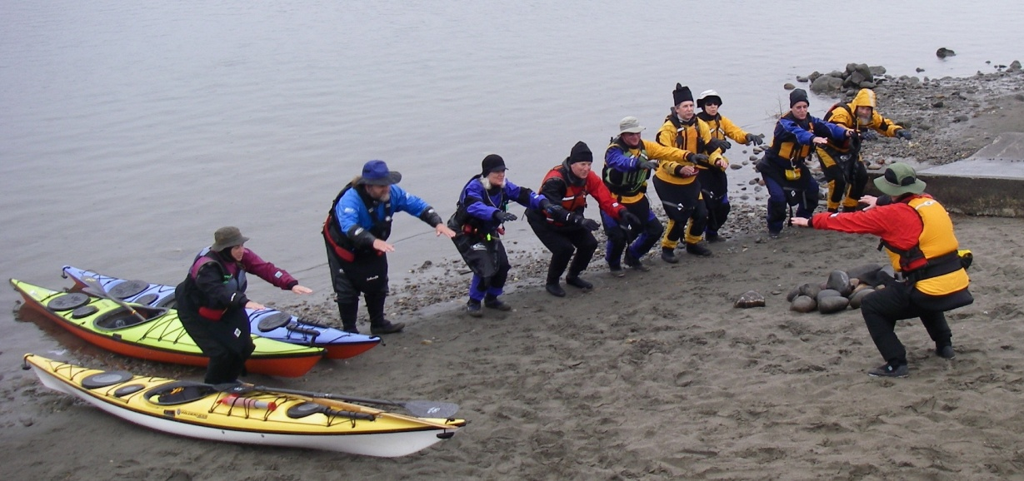
Groups that work
A group of people working together with a common goal.
  Our target: A group that is greater than the sum of its parts
  A common result … cat herding
The four stages of Group formation
  Form: the people come together
  Storm: the initial chaos … individuals working in proximity
  Norm: Individuals pulling together with a common goal
    The collection of people becomes a pod.
  Perform: The pod is greater than the sum of its parts
A good leader deliberately drives a group through these stages … quickly:
  Clear communication
  Consider games to “form the group” and get them to the Norm stage ASAP

Slide 130
Forming a Group on the Land
Helping each other get the boats to/from the water
Signing the waiver
Pre-trip briefing
Group warm-up exercises
  Mutual embarrassment helps form a group
    Be your favorite zoo animal
    Circus machines
  Share favorite stretches
  Throw a Nerf ball to someone in group, call out their name, and say your favorite food

Slide 131
Forming a Group on the Water
Raft up, have one or more people walk across all the boats
Shields and Aliens while traveling
Formations to do at half-speed
  “Blue Angel” fighter jet formations – now start swapping positions
  Form a line in direction of travel – back paddler weaves through line to front
  Form a line perpendicular to direction of travel – people from left and right switch positions
Pairs of crack-the-whip, paddle in circles, figure 8s
Everyone shares favorite foods while paddling together and calling each other by name
Close eyes – how many paddlers?

Slide 132
Assessing Participants on the Water
You’ve done the interviews, and you know some of the people, but what about the ones you do not know?
How they load and get into their boats will tell you a lot. As will how they hold their paddle and the first few strokes
Additional assessment exercises
  In a circle, bows to a common point; paddle back 4 strokes, turn 360, return bows to same point as fast as possible
  Eyes closed in boat – take off spray skirt, or put down paddle and wave hands around
Assess your paddlers early and adjust the difficulty/length/etc. of your trip so that everyone has fun and isn’t pushed too far outside of their comfort zone
This also helps form the group

Slide 133
The Group Underway
The Organizer and Co-Organizers should have theirs radars at maximum 360-degree range and adjust the paddle as necessary:
Looking out for moving or static hazards
Looking out for changes in conditions (weather, tide, swells, etc.)
Keeping track of the group (headcounts, now where is Joe going?)
Keep track of the condition of each paddler
Keeping track of where you are, and taking action to determine your position when you cannot agree (recently one trip deviated 90-degrees from the correct course)
Keep track of time, actual group speed
Keep safe-havens in view
Etc.

Slide 134
Helping keep things together
Use games and activities to keep the group together
  Aliens and shields
  Paddling in changing formations
  Exchanging favorite foods in a speaking voice with someone else by name
  Take turns drafting each other as closely as possible
  Group navigation exercises
Use pods, or buddies
  Everyone counts off and remembers their numbers
  Pair people – pairs are responsible for knowing where the other is at all times (don’t necessarily need to paddle together)
  Consider a “slow pod” and “fast pod” who have to meet at various milestones. Each needs proper organizer and first aid ratios

Slide 135
Spotting Paddlers who are in Trouble
Signs:
Paddling differently:
  Was relaxed and taking in the scenery, now is stiff, collapsed in on themselves, and looking straight ahead or slumped and paddling slowly
Has stopped paying attention to the group
  Tunnel vision and powering ahead
Saucer eyes, fixed grimace
If you and your help are struggling, likely so is everyone else

Slide 136
Dealing with Paddlers who are in Trouble
What to do:
Try to engage in conversation, “train spotting,” etc.
Get someone who is still OK to buddy with them – the psychological tow
Teach them combat breathing: inhale for 4 seconds, hold for 4, release for 4, hold for 4. Results in an autonomic drop in heart rate by about 20 bpm.
If more than one person is having problems, raft up and have them secretly show comfort level from 1-5 (fingers up behind back or with eyes closed)
Don’t be afraid to “call it” – “This Beach Looks Really Nice to Me!”
  If you are struggling, or observe that people in the group are struggling, go to shore.
    Likely everyone felt a bit over their head and were waiting for someone else to say so too – remember the social pressure and momentum heuristic traps?
  Ideally your nearest bailout point, else closest safe landing
Listen to your gut

Slide 137
Exercise
Discuss a time when you were in trouble. What happened, what were you aware of, and how did someone help you?
Charles: Tillamook crossing from Three Graces to lunch spot in wind from the sea with a boat coming into the harbor

Slide 138
The Positive Leader/Paddler
Look Positive
  Look where you want to go
    Naturally adjusts your body and boat to go where desired
Point Positive
  Point in the direction you want others to go
  Because remember #1 – if you point at the hazard, they will go towards the hazard!
Speak Positive when coaching someone to grow
  Mention only where you want to go/what you want to do
  The time to show the true severity of hazards is either during the on-land scouting (risk assessment) or during later reflection
    The heat of the moment is definitely the wrong time – freaked out paddler not a safe paddler
  Save the war stories of other paddles for the bar afterwards
  Don’t direct someone to their peril (don’t say “look at that nasty rock” – remember – they will go where they look)

Slide 139
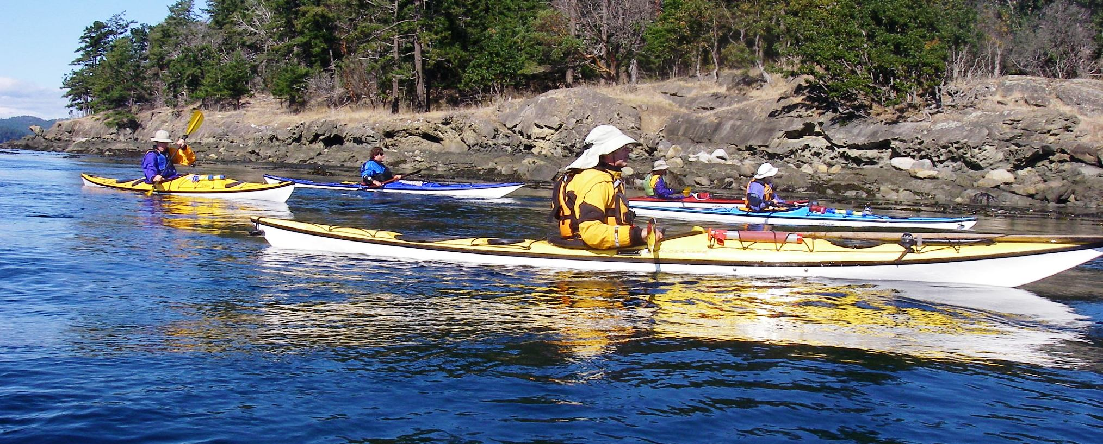
C.L.A.P
Key aspects of a well managed group: C.L.A.P.
  Communication: agree on communication plan up front, all can hear
  Line of sight: Ideally, all paddlers should be able to see everyone else
  Anticipation/Avoidance/Awareness: Its easier to avoid trouble than deal with it
  Position the leader for maximum effectiveness
The trip leader

Slide 140
Some Group Management Ideas
Use point, sweep, and wing paddlers for beginners and hazardous situations.
  Point looks behind him/her-self … sets pace so slowest paddler can keep up.
  Outriders can also form a “pen” to contain other paddlers
Have fun … don’t be a control freak.
  Conditions dictate how tightly you manage the group.
  Be assertive and take charge when needed
  Games are a way to keep group together without being a control freak
Give the control freak participant or the worry-wort something to do
  Assign them as Sweep, wing?
  Empowering them keeps them busy, helps keep the group together – assuming they don’t become an even bigger pain

Slide 141
Management Challenges – The Turtle
Weak Paddler/Wrong Boat
  Use them to set the group pace…from near the front; or lead paddler should go at speed of turtle
  Maybe pair with fast paddler or have them draft in the middle of a single-file line (follow as closely as you can)
  Have the group paddle in changing formations that pace the turtle
  In a wind, paddle upwind of them to break some of the wind and make it easier for them to control their boat
  May need to tow at some point while they paddle – use your rabbit for that!
Afraid
  Give them a relaxed buddy or provide instruction (while keeping your radar going)
  Talk to them! Try to make them see beyond the bow of their boat (“train spotting”)
  Play a game like Aliens and Shields, favorite fruits, etc. to help them break their fear

Slide 142
Management Challenges – The Turtle cont.
Ideas on Managing a group with slow paddlers
  Ramp down the trip level
  Slow group down by exploring shore
  Shift the group towards activities rather than travel – try to accommodate
Red flag if you have critical timing on parts of the trip (need to make tidal slack at a certain point in journey)
  Will likely require a change in the itinerary
  Remember – navigate from safe haven to safe haven…including the ones behind you.

Slide 143
Management Challenges – The Rabbit
Ideas:
  Have rabbits race each other around the group if situations allow, or conduct scouting missions to check something out, then come back and report
  Maybe we just need to give them something to do…other than set pace.
    Have them tow the slowest paddler, or you, to slow them down?
  Have rabbits race, towing the turtles – burn off that energy!
  Never tell them your heading – shift the entire group 45 to 90 degrees at random so these guys end up “behind”. Do this early on, keep them guessing, and they’ll catch on.
  If practical: give them the longest paddle and the shortest/widest boat?
  Talk to them about leadership, how you don’t need to be the fastest to be strongest, and have them act as a buddy for a slower paddler
  Challenge them to paddle backwards for as long as possible

Slide 144
Management Challenges – The Rabbit cont.
A leader who says “follow me” and then powers off into the sunset not looking back is not a leader – assume authority and form your own pod
We want to be inclusive, but if keeping rabbits in check endangers the group or makes the paddle hell to manage (such as splitting up the group to chase them down), you may need to cut them loose
  Carefully – important to stress keeping with the group in pre-trip briefing

Slide 145
Management Challenges – The Butterfly- Collector / Birder / Photographer
For some, giving them the responsibility of running sweep may cause them to keep up with the group
Let them wander if they stay within voice distance
Pair the wanderer with someone that can talk and paddle to shepherd them
In low visibility, give everyone a number and have them call it off during “count off”. Use prearranged “where are you” and “I am here” whistle signals.
Try to find these folks during screening, and create a trip/pod with objectives that can accommodate their…dallying
We want to be inclusive, but if they cannot keep focused enough to keep with the group, you may need to cut them loose
  Carefully – important to stress keeping with the group in pre-trip briefing

Slide 146
Management Challenges – The Butterfly- Collector / Birder / Photographer
More thoughts on cutting these folks loose
  Benign conditions
    If they will just not stay with the group, I'm not so worried about letting them go on their own way after "setting them free" with witnesses.
    They aren't really part of the group at that point but are basically just "hanging around in the vicinity".
  Potentially dangerous conditions (worsening weather, chance of getting lost, falling darkness)
    If the person is intentionally straying, try to use the group to corral them, or even put a tow on them.
    If they are straying unintentionally, I'd put a tow on them and use the group to bring them, and the rest, to safety.

Slide 147
Management Challenge – the Storyteller / Life of the Party
A double-edged sword
  May slow down the group or cause people to split apart
  But can also help with group cohesion, and help keep people paddling close to each other
    This paddler can also help ease the fears of some novice paddlers…assuming they don’t make people feel inadequate
You may need to break in to make the enthralled group aware of a course change or hazard avoidance
  Or you can subtly herd them, putting yourself between them and the hazard
  You might be able to use your rabbits to herd them – making it a game – how far can you get them without them noticing?

Slide 148
Management Challenges – The Paddler Who Has to Leave “Early”
Try to find this out when people sign up/days before
If you cannot guarantee a specific return time, suggest that they do not come on this paddle
  Especially if tides, winds, or amazing natural scenery could slow group
If you are stuck with them on your trip
  Shorten your itinerary from the start
  Plan to break up into two regulation pods, one that goes back earlier
  Send them back with an experienced buddy
Worst case, let them leave the group after signing a waiver with witnesses
  Ideally, no one paddles back alone
  Have then contact you after they return so you can be sure they made it safely

Slide 149
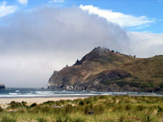
Scenario 1
You are leading a trip to the Salmon river and around Cascade head.
Conditions:
  Mid morning in October
  NW Wind 10 kt. AM growing to 20 kt. in the afternoon
  W swell 3 ft, 8 sec period
  Morning fog burning off in the afternoon.
  Low tide late in the day

Slide 150
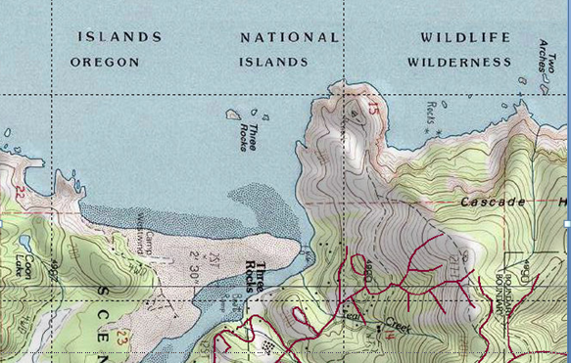
Cascade Head
North
Conditions:
Mid morning in October
NW Wind 10 kt. AM growing to 20 kt. in the afternoon
W swell 3 ft, 8 sec period
Morning fog burning off in the afternoon.
Low tide late in the day
What are the hazards? Where would you position yourself as you take a group around the head? How do you take the group around the head?
Salmon River

Slide 151
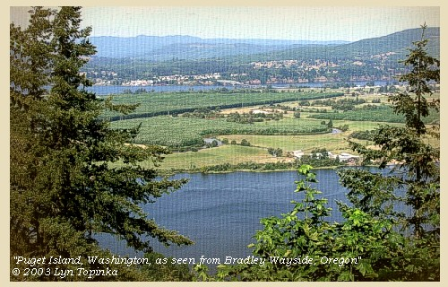
Scenario 2
You are leading a trip along the southwest shore side of Puget Island (on the Columbia River).
  Late morning in mid-April
  Sunny and clear
  W wind, 15 kt.
  Low tide late in the afternoon

Slide 152
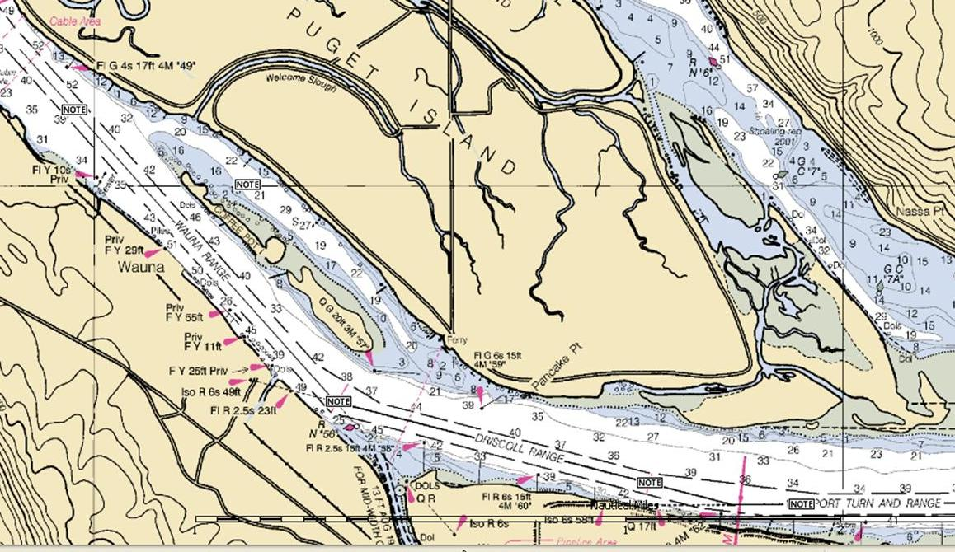
Columbia River/Puget Island
  Late morning in mid-April
  Sunny and clear
  W wind, 15 kt.
  Low tide late in the afternoon
What are the hazards? Where would you position yourself as you take a group along the island?

Slide 153
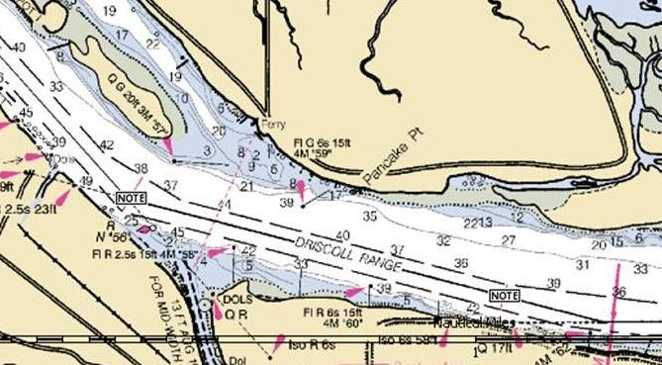
Columbia River/Puget Island
Wing dams! Shipping channel! Ferry!
  Late morning in mid-April
  Sunny and clear
  W wind, 15 kt.
  Low tide late in the afternoon

Slide 154
Exercise
List some of the things that can go wrong in a trip

Slide 155
Some “answers:” Things that can go wrong on a trip 1
Injury getting boat to/from water – always 2-people carry!
Car keys locked in car
Someone gets too hot or too cold – intervene before this goes bad
Rough water and windy crossings – encourage, coach, buddies, avoid if practical
Serious Illness or injury – know the signs, call for help ASAP
Someone capsizes and can’t get out of boat – seconds to save them – Hand of God!
Group gets separated – prevent, make sure everyone knows plan, search in pairs, bring radios, have meeting points

Slide 156
Exercise “answers:” Things that can go wrong on a trip 2
Rescuer or rescuee unable to complete rescue – get them help, try alternative methods (extra helpers)
Gasket in dry suit breaks – temporally fix with gorilla tape
Zipper not fully closed and suit floods – have buddies check each other before leave, change clothing (bring spares)
Boat needs repair on water – gorilla tape hole with boat across your deck after drying around hole

Slide 157
Some reasons why things can go wrong
Missed crux moves (missed slack tide during crossing)
Miscalculations (you got the wrong mileage, bearing, tide, positioning, etc.)
Accumulations of small errors (longer lunch than expected, a seasick paddler, starting early, slightly wrong bearing on a long crossing)
Overwhelmed by conditions
Failure to reassess

Slide 158
Incident Management
Maintain C.L.A.P. when something goes wrong
  The leader should delegate someone else to handle the issue while they maintain global awareness, count heads, and collect the group
  Round folks up rather than rubber-necking in a circle – raft up for stability
  If the leader is the only one skilled enough to handle the problem, delegate the job of “safety officer” to someone who isn’t freaking out before jumping in.

Slide 159
Handling an Incident – S.A.F.E.R
  Stop! (Count to 5, take a few deep breaths).
  Assess
    Full 360 scan counting heads, noting upcoming hazards, etc.
    Consider how much time we have
    Are things getting better or worse?
    Do we have a breathing emergency?
    What other risks are there, etc.?
  Form a plan (simplest with lowest risk preferred; also, what mode are we in: cruising/rescue/salvage/etc.?)
  Execute Plan
  Reassess (did it work? Do we need to move to more risky/complex solution to the problem? Go back to A)

Slide 160
Incident Management cont.
As a rescuer, your responsibilities are to S.T.E.V.E:
  Self
  Team and their equipment
  Every other river user (don’t endanger others to do your rescue)
  The Victim
  Their Equipment
Don’t become part of the problem - pause and look at the big picture before responding
  Consider the Simplest rescue first: "Shout, Reach, Throw, Row, Go for help”
  Always pay attention to where the wind and current are taking you
    This is why you need others watching out for overall safety as well

Slide 161
Post-Incident Management
Consider if others, or the same person, are likely to have the same problem again?
  Have conditions, or fatigue, pushed the level of this trip higher than expected?
  Or has someone reached their limit?
Be honest with yourself – is it time to end the trip?
  Seasick, exhausted, or scared people are not having any fun…which is contagious
  Hopefully you will realize this and head for shore *before* there is an incident

Slide 162
Paddles where special care is needed
A level 1 when conditions start to worsen
  When one person has problems, many will follow
    The kayak shops see this all the time
  Smile, be supportive, and get them off the water
  Which is why it’s always good to have a backup experienced paddler with you
Any paddle (especially level 2) in an environment where the weather (in particular wind) can change quickly with our without warning and/or there are very few or difficult outs
  This could quickly turn into a level-4 mess

Slide 163
As the paddle ends
Have brief discussion about what went well / could have been done better
  Rose and thorn, best thing that happened and something learned
Thank everyone for being on your paddle
Make sure everyone helps load boats
Discuss paddle during after optional paddle-dinner
This helps people learn from each other, lets the people who saw issues pass this on in a non-threatening environment to those who may not have noticed the potential hazards

Slide 164
Exercise
Tell the group about the best leader/guide you have ever been with, or someone who just didn’t get it
Charles good: Cheri and Turning taking us out to play with them. Bad: towing exercise where the leader paid no attention to the tension of the tow rope behind them or the rest of the group

Slide 165
Recommended Reading
The Complete Sea Kayaker’s Handbook – Shelly Johnson
Sea Kayaking Illustrated, a visual guide to better paddling – John Robison
Northwest Marine Weather – Jeff Renner
Weather at Sea, weather forecasting made simple – David Houghton
Sea Kayak Safety and Rescue – John Lull

Slide 166
Thank you for coming!
Your feedback (positive or negative, public or private) would be highly appreciated

Slide 167
Backup

Slide 168
Agenda
Goals
Logistics and Legal
Trip Planning
  Trip Levels, Skills
  Conditions
  Safety & Risk Assessment
  Medical
Group and Incident management
Good organizers – a number of perspectives

Slide 169
What makes a good trip Organizer?
Good trip organizers remember that the reason people have signed up for our trip is to paddle and have fun. It is our job to see that they are successful.
Good organizers try to be inclusive – everyone on the trip needs to have fun
  If someone shows up that is a bad fit, it is your mistake, not theirs. Find a way to make it work if feasible
Good trip organizers strive to continuously improve … Pursue continuing education:
  Paddling skills (strokes, etc.)
  Seamanship, navigation, etc.
  Instructor Training and Certification
You should be able to coach others on how to do something, rather than doing it yourself!

Slide 170
What makes a good trip Organizer?
Good leadership behaviors
  Awareness of the WHOLE group
  Good communication prior to the trip.
  Well Organized … knowing where you are going before you get there
  Review what is expected so everyone knows what’s going on.
Behaviors to avoid
  Taking too long to get on the water … showing up late or on time but not ready to go.
  “Over managing” … not allowing an appropriate degree of freedom WITHIN the group.
  “Under managing”

Slide 171
Leadership in the military
Basic leadership tenets in the military are:
Outline the mission
Define the parameters / resources available ( weather, conditions, distance, etc.)
Discuss personnel
Delegate
… and finally Supervise and monitor…
This approach covers situational awareness, pod unity / cohesiveness, and interdependence of the pod members.

Slide 172
What makes a good leader?
The Trip Organizer Rubric: part 1
Group Management:
  Identifies weakest spot in group and positions self for assistance.
  Knows where each person in the group is at all times.
  Identifies behavioral changes in individual group members
  Acts upon new information to preserve the integrity and safety of the group
Towing:
  Know when to tow and when not to tow.
  Demonstrate hooking into one or more boats.
  Set up an inline tow.
  Use a quick release.
Rescues (ideally this is *Not* the lead organizer – maintain CLAP!):
  Take charge; give the swimmer calm, clear and concise instructions.
  Maintain control of boats, paddles, and swimmer
  Have the swimmer back in their boat within one minute in conditions one level above the trip rating.
  Able to rescue a paddler who cannot help themselves (scoop rescue).
  Make sure your group size is the same before/after rescue – did someone go paddling off?

Slide 173
What makes a good leader?
The Trip Organizer Rubric: part 2
Use of Planning Resources:
  Charts – Know fetch, depth contours, possible landing spots, chart symbols
  Weather – Know at least three different resources for forecast information
  Tides - Know more than one resource for tide height data
  Currents - use NOAA website to pull information on currents, where applicable.
Communication:
  Be polite but firm.
  Be friendly, positive, encouraging, patient, realistic, energetic, and tactful.
  Good trip leaders remember that the reason people have signed up for our trip is to paddle and have fun. It is our job to see that they are successful.
  Observe each member and be sensitive to individual situations.

Slide 174
Concepts of Trip Leadership 1
Follow C.L.A.P.
  Communications, Line-of-Sight, Awareness/Avoidance, Position of Maximal Usefulness
Maintain situational awareness
  Watch for oncoming waves, weather, hazards, shipping, etc. in all directions and anticipate/avoid issues before they arise
  Keep an eye on how all participants (including self) are doing
  Constantly re-assess risk/plans
  Red Flag if you struggle to maintain awareness
Know where someone will drift (accounting for currents and hazards) if they dump or get separated from their boat
  Stay away from hazards with this in mind

Slide 175
Concepts of Trip Leadership 2
Learn to dance without looking at your feet
  Build your skill and speed so you can keep a 360-degree watch, interact with group, and move among or around them without having to concentrate on how you are doing it
Keep some gas in the tank – shorten the trip as necessary
  Make sure people have enough energy to get home if they are paddling in a headwind or there are more rescues than anticipated
In case of trouble, follow S.T.V.E
  Care for self (S), then your team/their equipment/other water users (T), then victim (V), then their equipment (E)
Simple to complex – or Keep It Simple Stupid
  Corollary for rescues and S.T.V.E: Shout, Reach, Throw, Row, Tow, Don’t Go (call for help)"

Slide 176
Concepts of Trip Leadership 3
Keep a light hand on the tiller, but not too casual – take it seriously
  Keep the trip fun but safe. Be chilled, or authoritative, as necessary. People are more likely to comply if they know why they are being asked to do something
  Use tact and subtle coercion for paddlers who stray from the pod
  But if someone is hypothermic, warm them. If unable to make way, tow them
  And if someone endangers the pod, be assertive – remember S.T.V.E
Become Adept at Non-Verbal Cues
  Learn to spot tired, sick, frightened, or overwhelmed paddlers and deal with each appropriately. Keep up a constant reassessment
Navigate from Safe Haven to Safe Haven
  Know all the places people can rest and sort things out
Learn to manage the jackrabbit and the turtle
  Have one tow the other, rabbit race each other around group, drafting with the turtle in the center

Slide 177
Concepts of Trip Leadership 4
Pre-Trip Warmup and Paddler Assessment
  Use quick games/activities to form the group and observe paddlers and assess their true skill level: quick turns, tennis ball basketball, shields and aliens, crack-the-whip.
Delegate, delegate, delegate
  Sweep, point, point-watcher, boat-spotters, pace-setter, etc.
  This includes not being in the center of rescues – let someone else do it while you maintain global awareness, count heads to make sure you know where everyone is, call back people who didn’t know a rescue was happening, etc.
  If you are the only one skilled to do the rescue, delegate someone else to count heads, corral, chase down the clueless
Be there for everyone, not just your paddle buddies
  Make sure to spend time with everyone and be aware of their needs (such as looking for non-verbal cues)

Slide 178
Concepts of Trip Leadership 5
Beware the deceptive “ease” of level 1 trips
  Have good co-organizers and play some quick games to let you assess everyone’s skills. Someone who struggles while fresh may cut the trip short
  These people will have the most trouble if conditions change
Risk Assessment
  Have everyone be part of risk assessment at the start (what could go wrong and how we solve it)
  Continually re-assess as the trip unfolds – weather may change, someone may get too hot/cold, etc.
Take the pre-trip briefing seriously
  Everyone has a first time, be it first, first time, or in a given environment,…
  Different types of paddlers know different signals, have different skills

Slide 179
Concepts of Trip Leadership 6
Don’t be afraid to “call it” – “This Beach Looks Really Nice to Me!”
  If you are struggling, or are finding the group is struggling, go to shore.
    Likely everyone felt a bit over their head and were waiting for someone else to say so too.
  If someone is afraid or anxious, they are not having fun, and not paddling as well as they could
  Look for non-verbal cues
  Use anonymous votes (if necessary) to assess group comfort – eyes closed, raise hand over head – more fingers = more comfortable
  Listen to your gut
  Q: “What do I have to lose continuing on?” A: Possibly someone’s life
  Paul Kuthe: “Some of my best days paddling have been spent on the beach”

Slide 180
A good leader always has
A plan, a chart, and a bail out option
A ‘plan B’
A tow belt, spare paddle
A watch
Snacks, extra warm clothes
Weather/tide/current forecasts
A way to call for help-- cell phone, VHF radio
First aid and repair kits
Good judgment – pay attention to your gut – it’s OK to say “no”s
An inquiring mind – always looking for more to learn
A big smile and positive attitude.

Slide 181
Your Basic Toolset
Brain
Chart
Tide, current, weather information
VHF Radio
Grease pencil
Tow belt
Barometer (especially on multi-day travels)

Slide 182
Medical Backup

Slide 183
Cuts, bruises, strains, breaks
Issues
  The longer you wait to treat, the greater the complications
Symptoms
  Usually pretty obvious
Treatment
  Expose the wound so you can accurately assess
    Look for other injuries beyond the source of complaint – consider mechanism of injury
  Treat appropriately for wilderness conditions
    Keep dressing dry/on if possible
    Don’t allow patient to use treated part if possible
    Seriously consider safest appropriate bailout option to get patient to definitive treatment

Slide 184
Cold Water Safety
Wrong excuses for not wearing a properly secured life jacket:
  I can swim well, I am a skilled boater, I am close to shore, it’s only necessary if boat moving
Facts about drownings
  88+% were not properly wearing a life jacket
  34% (1 in 3) die in water between 50 and 68 degrees
  60% drown in water under 50 degrees
  43% were less than 7 feet from shore/safety (shore, boat, dock, etc.)
  66% were less than 50 feet from shore/safety
  Only 30% of those people could not swim
  Source: http://www.coldwaterbootcamp.com/pages/cfv2.html

Slide 185
A properly Fastened Life Jacket
All buckles buckled and zippers zipped
Bottom strap tightened securely under rib cage
Shoulder straps: room for some fingers under them, but no more
Properly fastened:
A person can be lifted from the water by their shoulder straps.
When they are in the water the PFD does not ride up around their head.

Slide 186
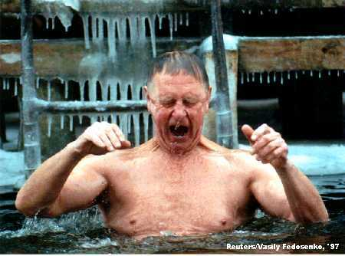
Surviving Cold Water (water under 77 degrees)
Hypothermia takes time … but you also have to worry about the body’s initial response to immersion in cold water… cold shock:
  Rapid, uncontrollable breathing (Hyperventilation, Gasping Reflex)
  Constriction of the capillaries under the skin causing an immediate increase in blood pressure and heart rate
When you fall into cold water … remember the 1-10-1 rule:
  1 minute to control breathing – most don’t survive this without a life jacket – nearly impossible to swim
  10 minutes to get out of 50-degree water
  1 hour to lose consciousness due to hypothermia in 50-degree water
Falling into *ice water* you only become severely hypothermic after 30 minutes…if you have life jacket on
https://www.youtube.com/watch?v=J1xohI3B4Uc
Photo credit http://www.enter.net/~skimmer/coldwater.html

Slide 187
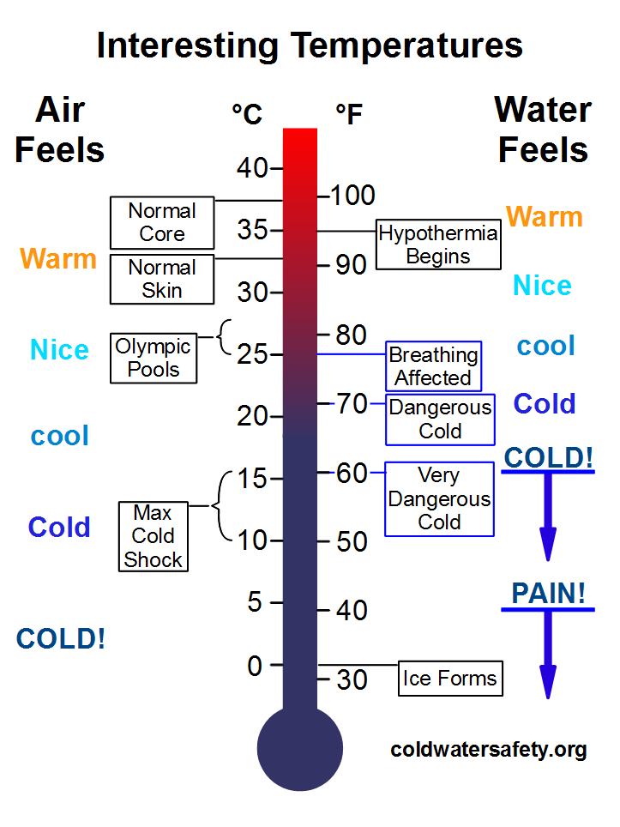
Why Cold Water is Dangerous

Slide 188
Why Cold Water is Dangerous
Sudden Drowning
With very few exceptions, immersion in cold water is immediately life-threatening for anyone not wearing thermal protection like a wetsuit or drysuit.
When cold water (below 77F) makes contact with your skin, cold shock causes an immediate loss of breathing control. The result is a very high risk of suddenly drowning - even if the water is calm and you know how to swim. The danger is even greater if the water is rough. Inability to coordinate your breathing with wave splash greatly increases the danger of inhaling water.
  Maximum uncontrolled breathing response from water 50-66F
The more skin protected from the cold, the less risk of uncontrolled breathing

Slide 189
Why Cold Water is Dangerous
Gradual Drowning
Cold water drowning can happen immediately, but it can also take a fairly long time – a gruesome, drawn-out process in which small amounts of water are inhaled, over and over again, until your lungs become so waterlogged that you suffocate. Inhaling about five ounces (150 ml) of water is enough to cause drowning.

Slide 190
Why Cold Water is Dangerous
Heart Failure and Stroke
Because skin blood vessels constrict in response to sudden cooling, cold water immersion also causes an instantaneous and massive increase in heart rate and blood pressure. In vulnerable individuals, this greatly increases the danger of heart failure and stroke.
All of these things happen long before hypothermia becomes an issue.

Slide 191
Why Cold Water is Dangerous
Stages of Immersion
To understand why some cold water deaths happen instantly, while others take hours, you need to be familiar with the four stages of cold water immersion, what happens during each of them, and why it happens.
Stage 1:Cold Shock
Stage 2:Physical Incapacitation
Stage 3:Hypothermia
Stage 4:Circumrescue Collapse

Slide 192
Why Cold Water is Dangerous
Cold shock is over in a relatively short period of time, generally within five minutes, however breathing problems may persist for a longer time while you’re in the water.
If you survive the cold shock phase, the threat shifts to physical incapacitation. It’s quite possible to lose the ability to use your hands in 60 seconds, and use of your arms in minutes.
It takes at least 30 minutes for an average adult to become hypothermic, even in freezing water. A very large person with a lot of body fat can delay both physical incapacitation and hypothermia, sometimes for hours. Size does matter.
The final stage, circumrescue collapse, derives its name from the fact that the collapse can occur before, during, or after rescue.

Slide 193
Golden Rules of Cold Water Safety
The 5 Golden Rules of Cold Water Safety are your roadmap through this jungle. While each rule is important in its own right, it's the combination of all five that allows you to build a strong cold water safety net.
1) Always Wear Your PFD
2) Always Dress For The Water Temperature
3) Field-Test Your Gear
4) Swim-Test Your Gear Every Time You Go Out
5) Imagine The Worst That Could Happen and Plan For It

Slide 194
Drowning
Issues
  You need to get them breathing again before their heart stops (because you have no way to restart in the wilderness)
Symptoms
  They inhaled water and they are unconscious
Treatment
  Make sure there is nothing stuck in the mouth to prevent drainage
  Turn on side to drain
  Chest compressions may help push water out
  Breathe for them and check for pulse, possibly in combination with the above.

Slide 195
Drowning
Drowning is the third most common cause of accidental death in the United States
8,000 deaths each year.
Worldwide about 150,000 people drown annually.
Statistical reporting on near-drowning is unreliable, but experts have estimated that there may be 600 near-drowning incidents for every reported drowning death.
“Bystander CPR appears to be the definitive action for drowning victims, not any other interventions, basic or advanced.”

Slide 196
Drowning
Paddler inhaled water and is unconscious
Problem
  You need to get them breathing again before their heart stops or even after
Treatment
  Make sure there is nothing stuck in the mouth to prevent drainage
  Turn on left side to drain
  Ideally on slight slope with head below feet
  Chest compressions may help push water out
  Breathe for them and check for pulse, possibly in combination with the above.
  “Bystander CPR appears to be the definitive action for drowning victims, not any other interventions, basic or advanced.”

Slide 197
Heat Issues – Hyponatremia
Issues
  Depletion of sodium in the blood from over-hydration combined with sweating
  Greater risk from prolonged exertion, diuretic use (so pee more), lack of acclimatization
Symptoms
  Variable, abnormal mental state
  Looks like heat exhaustion: Fatigue, weakness, headache, dizziness, nausea
  Good history critical: little or no food intake, high fluid intake, copious/frequent clear pee (by contrast heat exhaustion is yellow, infrequent), lack of thirst
Treatment
  Remove challenge: get in shade, stop exercising
  No fluids – treating like heat exhaustion will make worse
  Gradual intake of salty foods
  Resumption of hunger + thirst and normal urine input – problem solved

Slide 198
Diabetic Reaction
Issues
  A well-controlled diabetic can become uncontrolled with unusual exertion
  Lightweights may be more susceptible (smaller reserves)
  These people need to eat regularly – plan this into your trip!
  Uncontrolled diabetics have partial/total loss of feeling – unable to tell when injured
Symptoms
  Weakness, shaking, sweating, headache, nervousness, hunger, altered mental state (often combative)
  Diabetics usually know when they are having problems and can tell you about it
Treatment
  Start with 8-15 oz of fruit juice.
  If no improvement after 15 minutes, repeat and measure blood sugar
  After symptoms subside give more substantial food (peanut butter and jelly sandwich an excellent start)
  If symptoms do not subside get to hospital. If they do, then patient can carefully continue trip

Slide 199
Heart Issue
These symptoms match many problems.
If patients are at high risk of heart disease (i.e. they are a typical OOPS member) and if it comes on suddenly with exercise, assume it’s the heart
Issues
  Don’t let these people exert themselves even if symptoms “go away.”
  Make sure these people bring their medications and that they are easily accessible (plus backup medication in case primary dropped in water)
Symptoms (some or all of) – “atypical” in women, elderly, diabetics
  Chest pain/pressure (30% do not!), radiating pain in jaw or arm, rapid/shallow breathing, shortness of breath, nausea, sweating, dizziness, feeling of doom, denial, lower abdominal pain, pain in lower back, heartburn/indigestion
  Made worse by exertion
Treatment
  Rapid evacuation is essential. Keep patient calm and exertion low and get help FAST. Flag down power boats! Call for help! Time is of the essence!
  Help administer medication if they have any (nitroglycerin)
  325mg aspirin (chewed!!) can improve outcome
  Detect and intervene early … before CPR is needed (=they die in the wilderness)

Slide 200
Stroke
Issues
  Patient confused, frightened, maybe unable to communicate
  Time is of the essence
Symptoms
  FAST: (F)acial droop, (A)rm drifts when held out in front, (S)lurred speech.
  RECORD THE (T)IME when the patient first showed symptoms! Most important information needed by hospital
  Also suggestive: Over 45, no history of seizures, atypical in past 24 hours, OK blood sugar (diabetic emergency can look like stroke)
Treatment
  Calm, keep warm
  Fastest evacuation possible – best outcome if they get drugs within an hour; 3-4 hours on the outside
  Do NOT administer aspirin!
  Protect numb/paralyzed limbs – patient won’t know if damaged

Slide 201
Anaphylaxis
Issues
  The patient is about to suffocate due to an overwhelming allergic reaction and you can only slow it for 20-40 minutes
  Make sure two EpiPens and Benadryl are easily accessible
Symptoms
  Difficulty breathing and swelling in face/throat
    Itching with or without hives, flushed or pallid skin without respiratory distress is “just” an allergic reaction
  Shock symptoms (increasing heart and respiration, decreasing blood pressure before Epipen administered)
Treatment
  Apply EpiPen for 10 seconds as soon as breathing problems start
  Second EpiPen if no results in first 5 minutes; otherwise will need to administer again in ~20 minutes (once needed again)
  Use Benadryl to prolong effect of EpiPen
  MUST GET TO AMBULANCE IN 20-40 minutes to survive. PULL OUT ALL THE STOPS TO GET THEM TO ADVANCED MEDICAL AID (anyone with epinephrine)

Slide 202
Sea Sickness/Nausea
Issues
  Unless you have good medicines, patient will be unable to paddle and extremely miserable. Trip over.
  Vomiting over the side = patient drowns
Symptoms
  “Green,” pale, sweating, miserable
Treatment
  Get off the water
  Look at horizon
  Ginger or better *before* going on the water
  Try to determine if this is brought on by motion or food poisoning
  Vomit on spray deck and rinse off.

